Slide 1
North East & North Cumbria VCSE Partnership Programme
Lisa Taylor, Health & Wellbeing Programme Director, VONNE
Notes:
CAROL

Slide 2
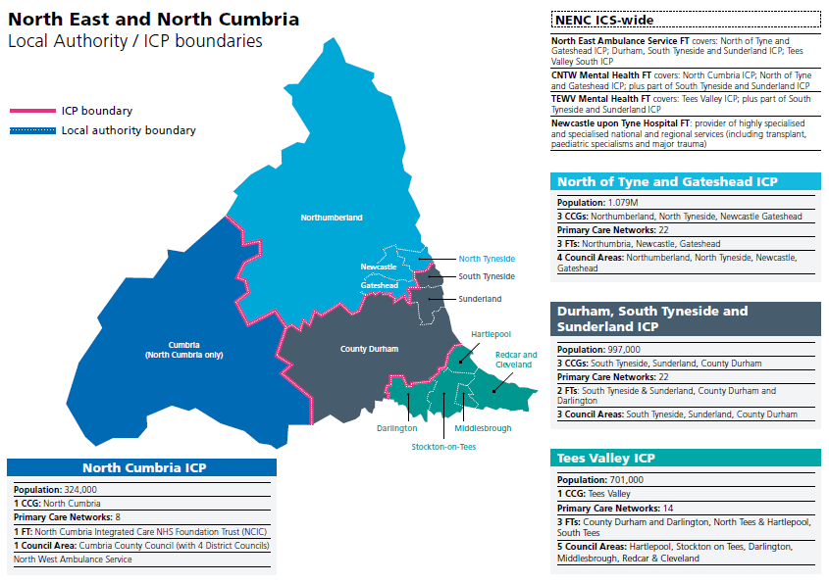
One ICS:
North East and North Cumbria
divided into
Four Area ICPs:
North
Northumberland
Newcastle
Gateshead
North Tyneside
Central
South Tyneside
Durham
Sunderland
South
Darlington
Hartlepool
Redcar & Cleveland
Middlesbrough
Stockton
North Cumbria
North Cumbria
Approx. 11,000 VCSE organisations in NENC ICS

Slide 3
NHSE VCSE Leadership Programme
Programme Aims:
Develop and test models of diverse and inclusive VCSE Leadership Groups or Alliances
Demonstrate the value of working in partnership with the VCSE sector
Support equal and sustainable relationships between VCSE and Integrated Care System (ICS)/Sustainable Transformation Partnerships (STPs)
Share learning between STP/ICS through action learning and peer support
Cohort 2 Targeted at 8 ICS’s – includes North East and North Cumbria ICS – Lead VCSE Partner VONNE
Funded by NHS England / NHS Improvement for 2 years – tapering basis – NHSE/I Funding ended Mar 21, ICS funding afterwards
Notes:
JANE

Slide 4
VCSE Leadership Programme Partnership structures
The partnership models developed in each area differed in structure, but all had some shared elements:
creation of a voluntary sector leadership group or alliance (a group made up of voluntary organisations aiming to be a broker for the wider sector and a single point of contact for NHS colleagues)
voluntary sector representation on public sector or cross-sector groups including the STP/ICS board
a mechanism for two-way engagement with the wider voluntary sector and wider partners and structures
a process for feedback to the wider sector.

Slide 5
NENC VCSE Partnership Programme Objectives
To create a mechanism to co-ordinate engagement and involvement of the VCSE sector in strategic planning, commissioning and design of services to support our communities.
To ensure a VCSE voice in collaboration across health ‘systems’ to enable a positive impact on heath priorities, support population groups and reduce health inequalities.
To provide an opportunity to share learning and review national and regional developments across health, wellbeing & social care, and recovery strategies.
To support the involvement of VCSE leaders within ICS governance and structures to support collaborative working and co-production in health and care services planning and commissioning.
To enable effective collaboration and coproduction with stakeholders to design and implement measures in response to the direct and indirect impact of COVID19.
Notes:
JANE

Slide 6
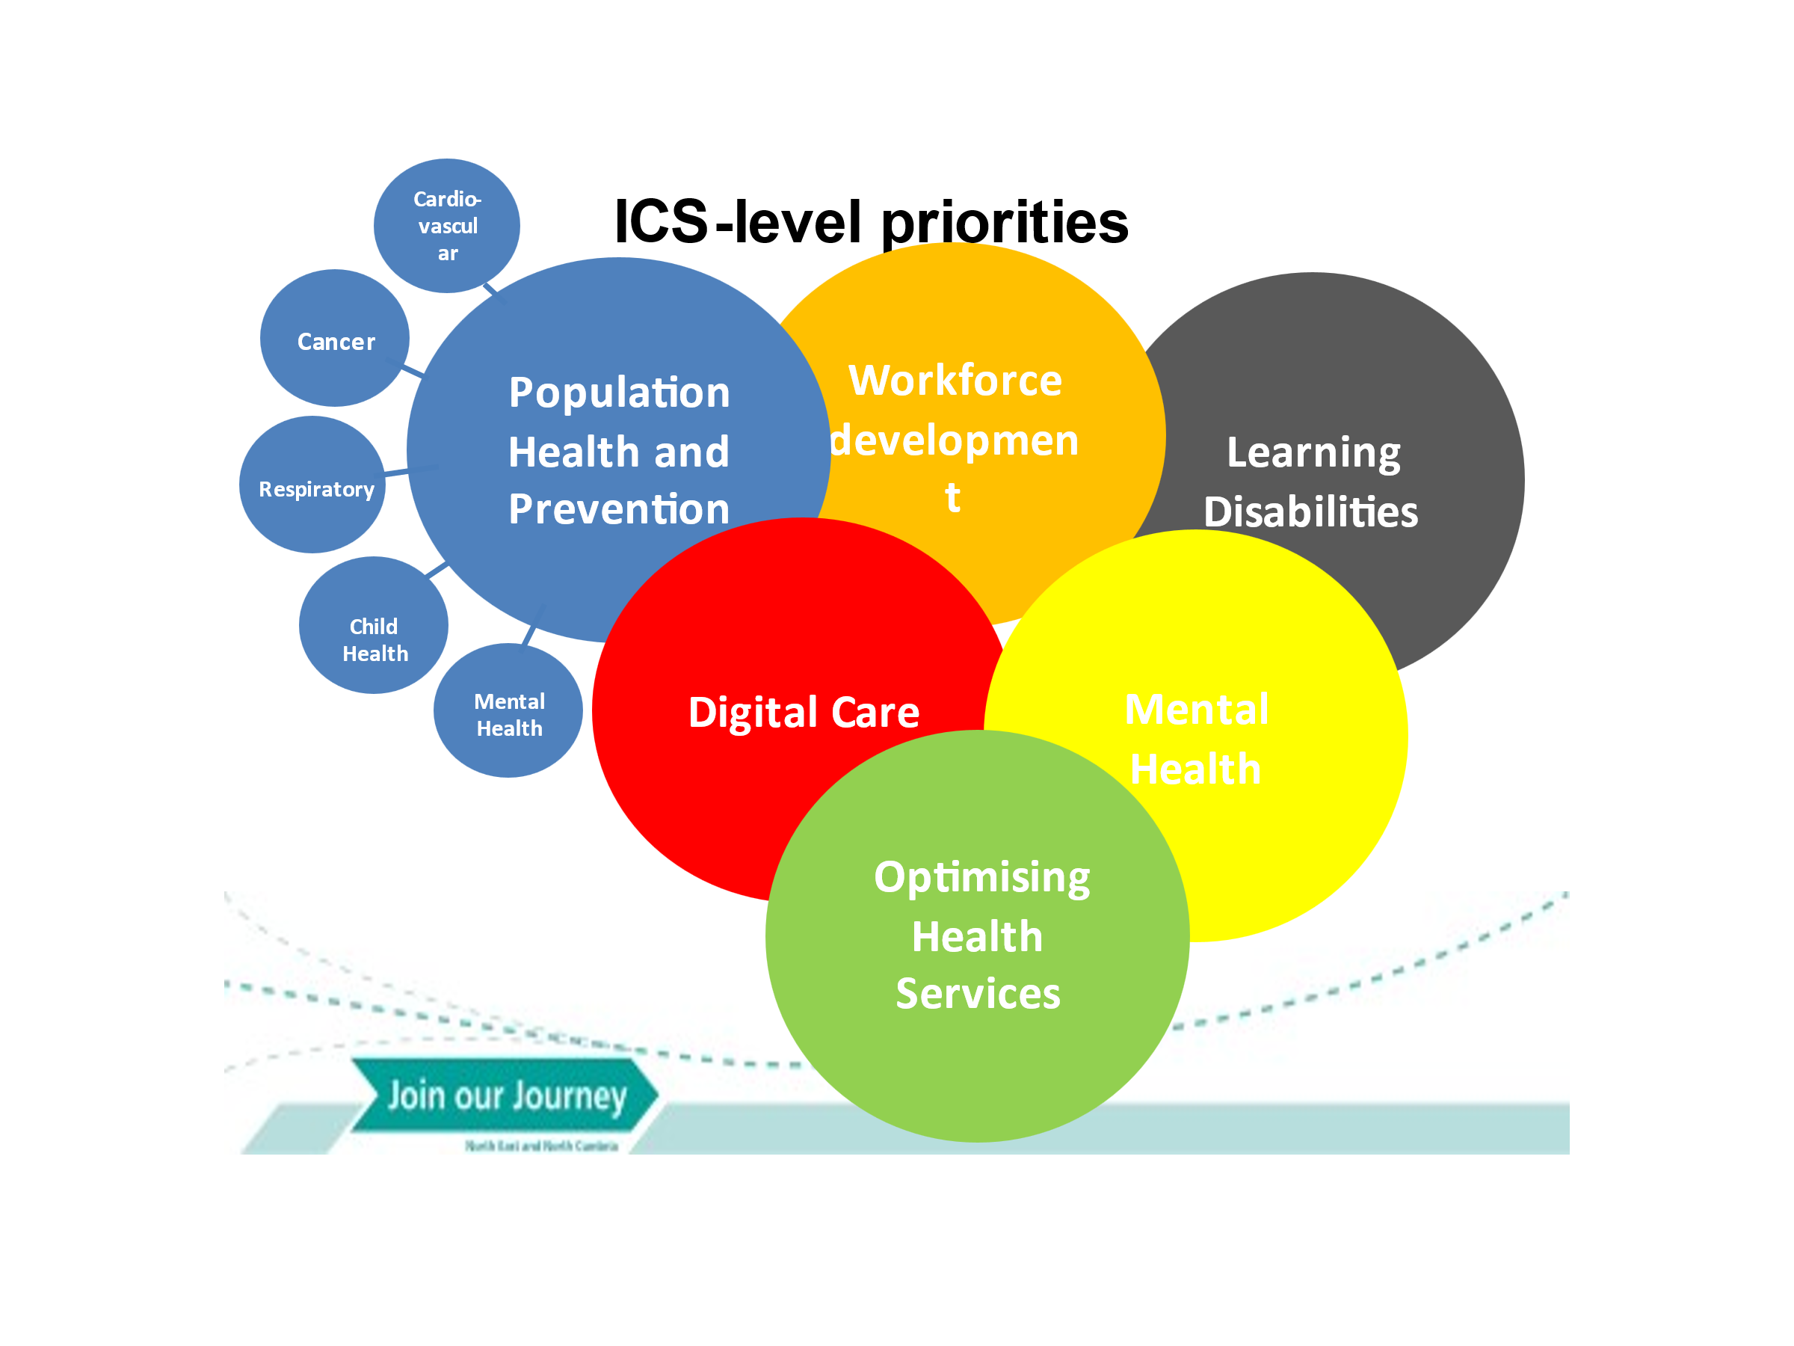
As the ICS develops, some of the priorities will change

Slide 7
NENC VCSE Partnership Structure
Virtual Health & Wellbeing Network
Cascading information network via bulletins & opportunity to be involved in working groups/sub groups/ focus groups
VCSE Partnership Forum - a range of organisations/networks represented to ensure broad VCSE sector knowledge and expertise across geographies and themes/ beneficiary groups. Membership of the Partnership Forum is of relevance to senior managers responsible for health and wellbeing policy and strategic work within their organisation
Enable a coherent and representative group of VCSE organisations for external stakeholders to engage with
Broaden out the representation roles and responsibilities so organisations with specific geographical or thematic expertise could represent the VCSE sector at the relevant forums/ boards/ structures
Support 2 way engagement /communication with wider network
Notes:
JANE

Slide 8
ICS and VCSE Partnership Programme Integration Structure
NENC VCSE Partnership Programme Multi-Agency Steering group
Ensures Programme remains strategically aligned and embedded within ICS, to support development of ICS objectives via collaborative partnerships, funded projects and information sharing
ICB - Integrated Care Board
Working collaboratively
ICP - Integrated Care Partnership
Nominated member/s, financially supported via ICS
VCSE Executive Group
4 Area ICPs including NHS, statutory and VCSE
VCSE Area ICP-level groups or networks (if needed)
Priority Workstream Groups including VCSE representation at strategic and operational levels
Place – level health and care alliances (info flows into as well as out)
VCSE Partnership Forum for VCSE health and wellbeing strategic organisational leads
Key
Clinical Networks including VCSE representation from sub-groups/Partnership Forum
VCSE Sub-Groups for VCSE to feed information in and out of Priority Workstreams and Clinical Networks
VCSE Steering Group
VCSE structures
Partnerships (cross-sector)
NHS structures
Primary Care Networks with links to VCSE organisations within their footprint
Health and Wellbeing Network to share information and opportunities with the VCSE sector*
Integrated Care
Board
*Other sectors welcome to join Health and Wellbeing Network

Slide 9
North East & North Cumbria VCSE Partnership Programme Executive Group formation and information flow
ICB Healthier and Fairer Advisory Group
NENC VCSE Communities of Special Interest Representation/
Vulnerable Groups
VCSE to feed into ICS Boards
NENC ICS Boards
End of Life
Mental Health
Learning Disability and Autism
Refugees/ Asylum Seekers
Black & Minoritised Communities
VCSE Executive Group
Prevention, CORE20+5,
NHS support to broader social economic disparities
Children/ Young People
Criminal Justice
Neurological
Long Term Health Conditions
Physical/Sensory Disability
Women/ Violence Against Women & Girls
LGBT QIA+
Older People
Carers
Cancer
Multiple & Complex Needs
Communities of Place/Neighbourhood
Local Infrastructure Organisations (LIOs) & Provider Networks
ICS Priority Workstreams/ Boards
Clinical Networks
VCSE LIO/Provider Network Leads
NENC Area ICP Structures
NENC Integrated Care Board (ICB)
North Eastern
LIO ‘s Network nominate 2 Northumberland, Newcastle Gateshead & North Tyneside reps
Northumberland
Northumberland CVA, CVA Blyth Valley, CAN, Thriving Together
North Tyneside
VODA
VCSE thematic Sub Groups
North Area ICP
Newcastle & Gateshead
Connected Voice
NENC Integrated Care Partnership (ICP)
South Tyneside
Inspire South Tyneside & South Tyneside Alliance
Sunderland
VCAS & Sunderland Alliance
North Eastern LIO Network nominate 2 Durham, Sunderland & South Tyneside reps
North East & North Cumbria VCSE Partnership Forum
LLIO leads, VCSE Provider Networks & Special Interest Group leads, Health Infrastructure leads, Health & Wellbeing strategic leads, facilitated by VCSE Partnership Programme
Central Area ICP
Durham
Durham Community Action, East Durham Trust
Darlington
TVRA/ D’ton Healthwatch
Potential additional committees and sub-committees
Stockton
Catalyst
Tees Valley LIO ‘s Network nominate reps x 2
South Area ICP
Hartlepool
Hartlepower
Redcar & Cleveland
RCVDA
North Cumbria
Cumbria CVS & Action For Health Network
Cumbria CVS – CEO / Health Partnerships Manager
North Cumbria Area ICP
Middlesbrough
MVDA

Slide 10
And…
Covid response supported collaborative working –connectivity/recognition and value of the VCSE:
Covid-19 Health Inequalities Impact Assessment
NHS Charities Together/ Winter Pressures Funding collaborative approach to design and delivery working with VCSE Partnership Programme leads & Co. Durham and Cumbria Community Foundations on behalf of the ICS area
Maternal and Perinatal Mental Health project – with MMH Clinical Network and Blue Stone Collaborative/Ways to Wellness
Third Sector Grant Funding Protocol – with NHS, Cumbria and County Durham Community Foundations – protocol subsequently expanded to all CF’s and used for Waiting Well funding
Community Diagnostic Hubs guidance – presented at national webinar and ensured national guidance changed to reflect the importance of working with the VCSE from outset
Research Engagement Network Development – bid partner with ICB and research, £84K of £100K direct to VCSE sector to explore Children & Young People’s Mental Health research

Slide 11
Thank You
Lisa.Taylor@vonne.org.uk
VCSE Engagement Manager Siobhan Flynn
Siobhan.Flynn@vonne.org.uk
www.vonne.org.uk
Join Membership+ to receive:
Funding information
Exclusive events
Free and discounted job adverts

