Slide 1
Third Sector Trends 2022 New findings on sector structure and finances
Tony Chapman, St Chads College, Durham University
Presentation for County Durham Better Together Voluntary and Community Sector Forum
Tuesday 6th December 2022, Durham Community Action

Slide 2
Third Sector Trends Study 2022
The study began in 2008 – so we can now do a lot of trend analysis to see what has changed and what stays the same.
The survey now covers England and Wales and received 6,070 responses in 2022,
We received 613 responses in North East England, 155 of which from County Durham.
A new baseline study of registers was also completed in 2022 with 187,300 cases – including all legal forms.
These two data sets can be used nationally or locally to assess the structure, energy, purpose and impact of the sector.

Slide 3
Some statistics for County Durham
On registers there are 1,405 ‘active’ organisations in County Durham: 712 charities, 146 CIOs, 171 registered societies (including CCBSs), 65 CASCs, 217 CICs, and an estimated 94 exempt but incorporated TSOs.
Cannot say how many are unregistered (‘below the radar’)… probably about 1,800.
Sector income in County Durham is about £345.7 million.
There are about 6,400 full-time equivalent employees in County Durham.
27,600 regular volunteers produce 1.9 million hours work – if they were paid it would cost £18.9 million, at 80% average regional wage £26.5 million.

Slide 4
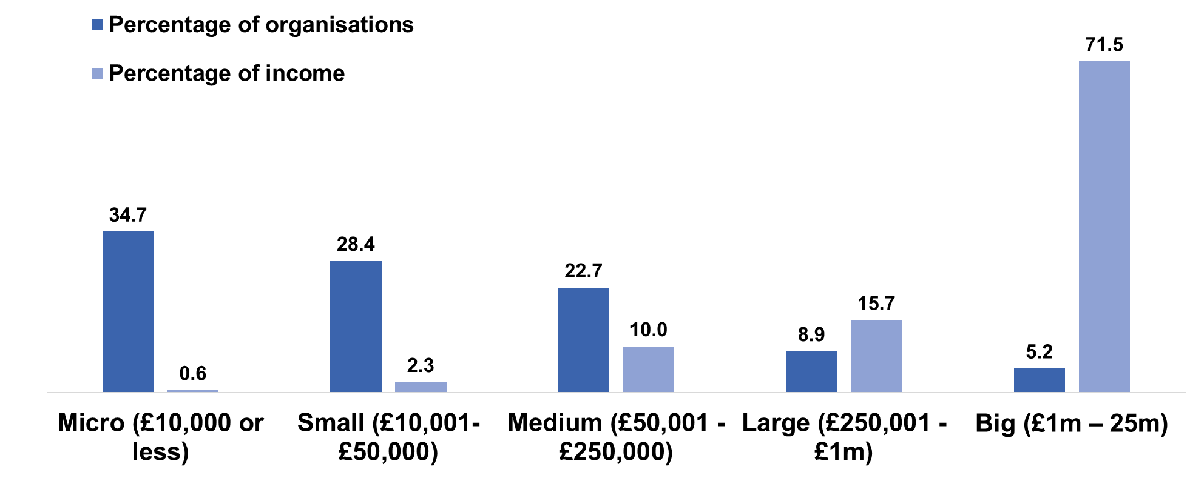
Sector Structure

Slide 5
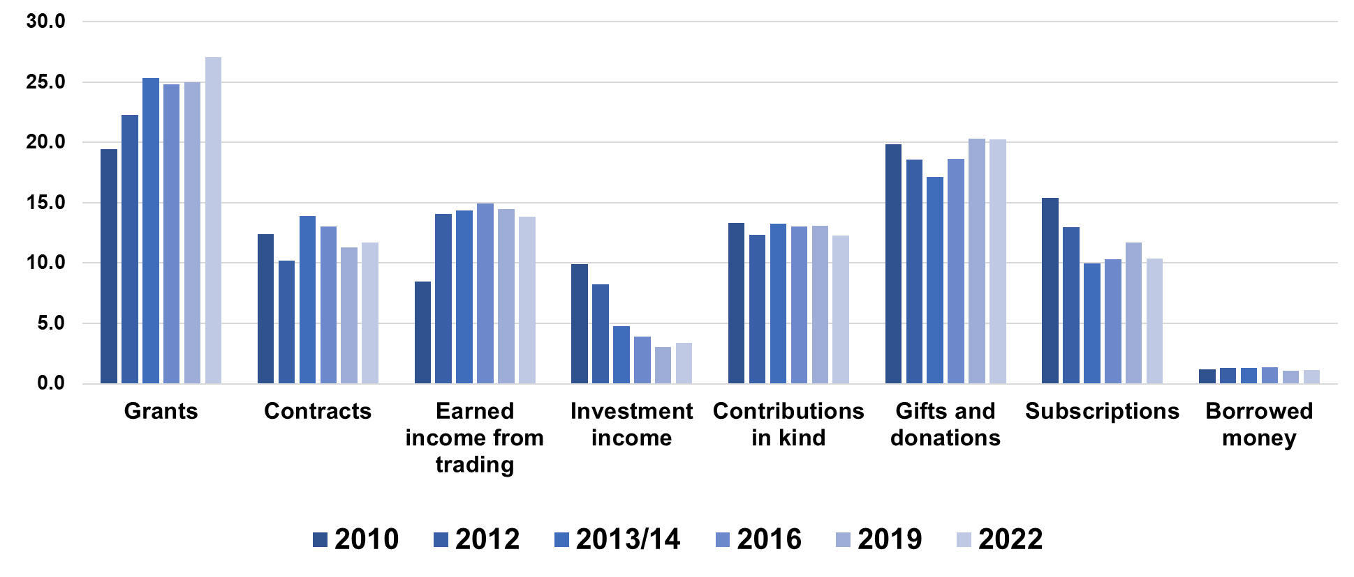
Changing income sources

Slide 6
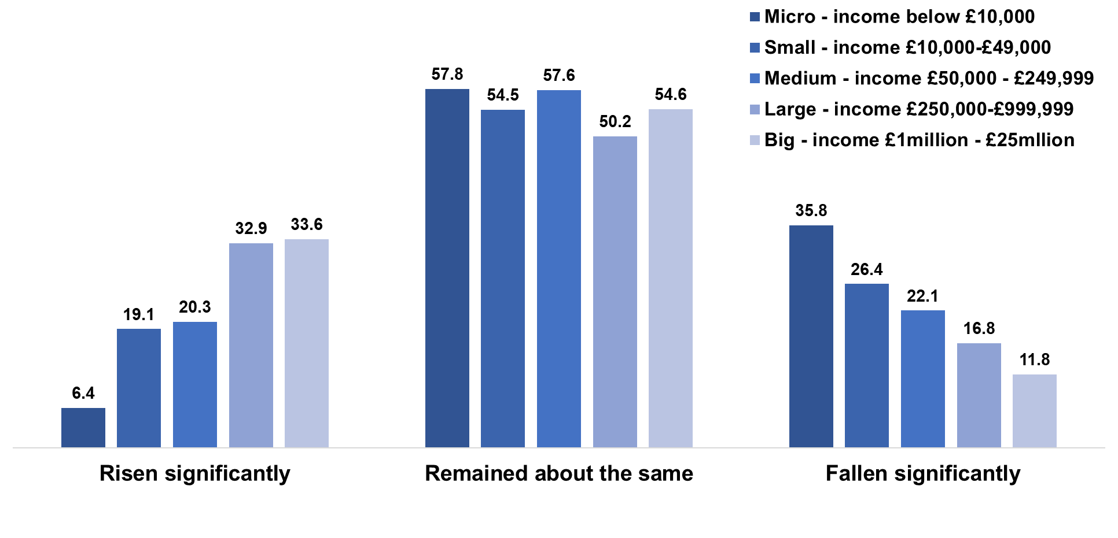
Income change in the last two years

Slide 7
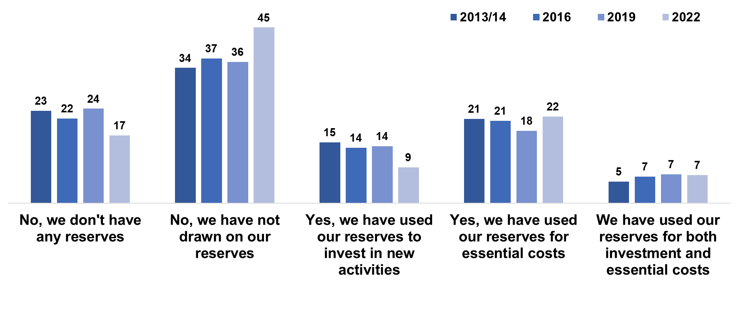
Ownership and use of reserves

Slide 8
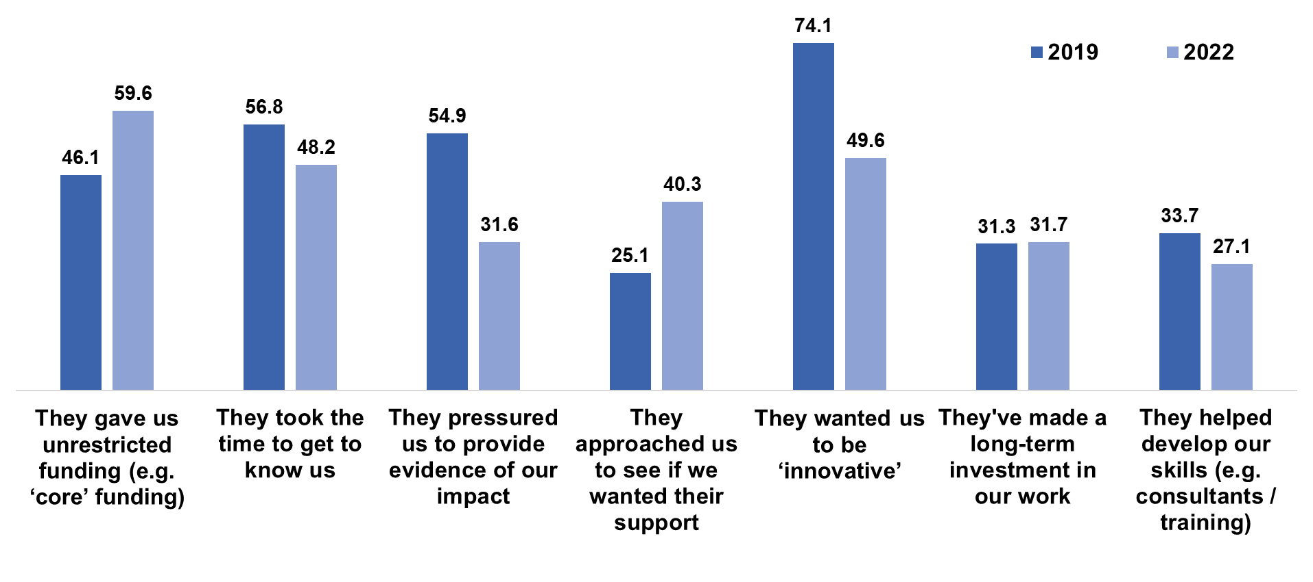
Relationships with grant funders

Slide 9
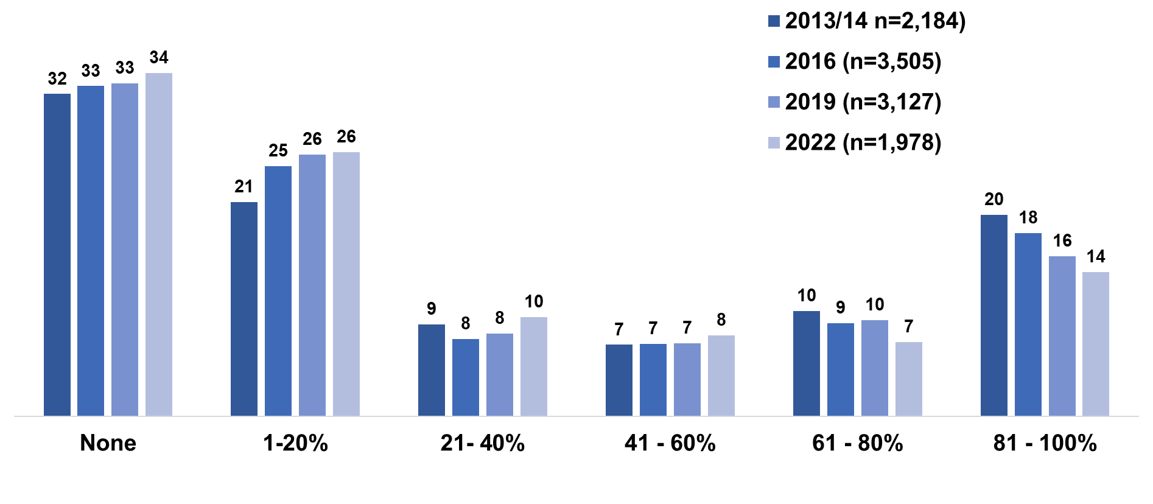
Earned income from trading

Slide 10
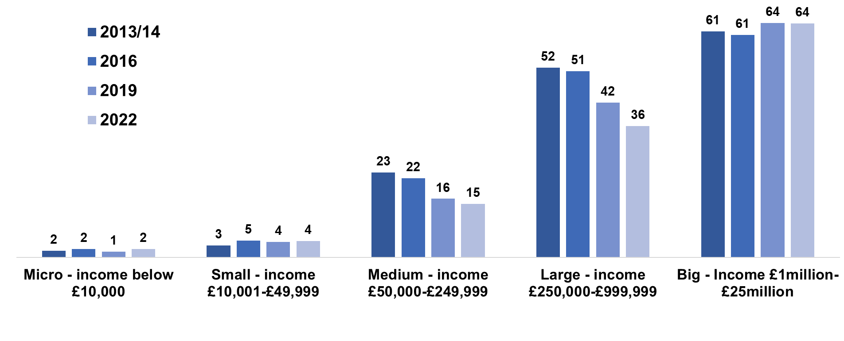
Public service delivery contracts

Slide 11
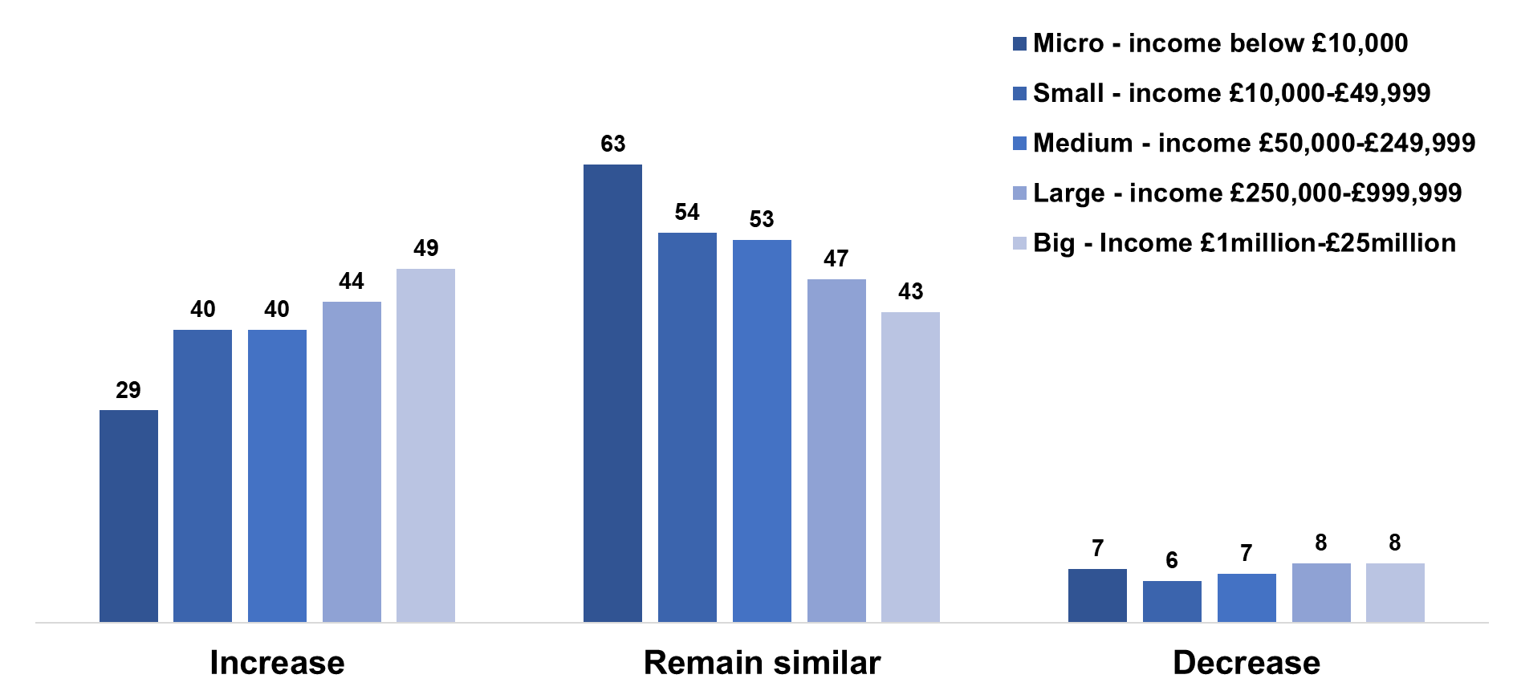
Expectations about income next 2 years

Slide 12
For more detail on the study, please feel free to contact me Tony Chapman St Chad’s College, 18 North Bailey, Durham University, Durham DH1 3RH tony.chapman@durham.ac.uk

