Slide 1
Tales from the Dales 6th September 2022 Grace Crawford Funding & Strategic Development Officer, UTASS

Slide 2
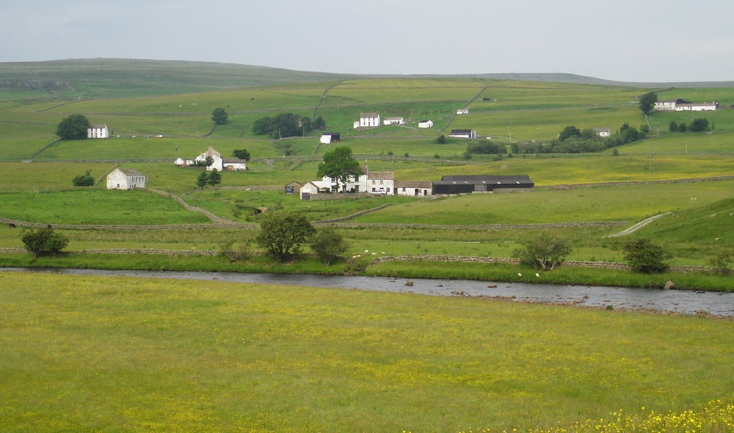
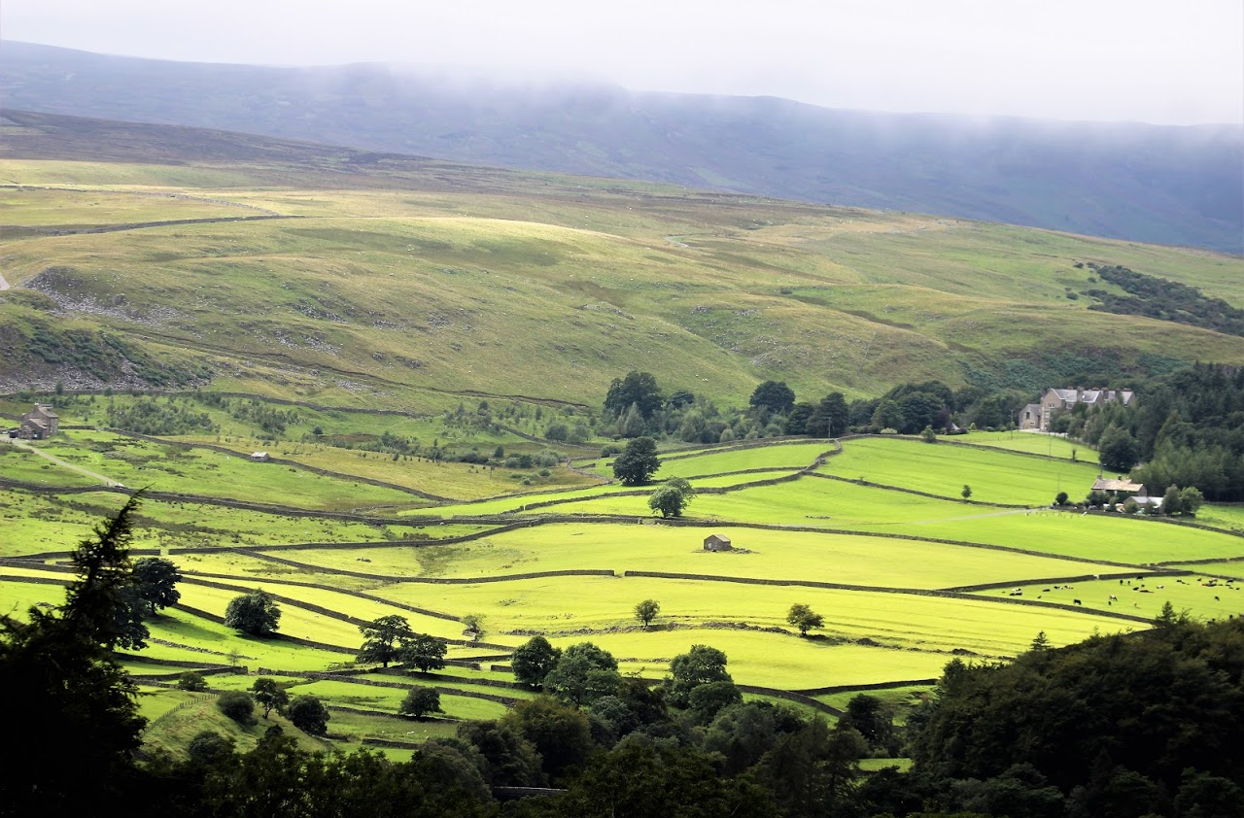
Where we work
Notes:
Just to add some context in terms of landscape, we can’t talk about Teesdale and Weardale without of course some images of much of the patch that we are talking about in terms of the area in which we work
Beautiful… rolling hills, traditional hill farms, stone walls, moorland… but of course it is the challenges of the landscape and particularly living and working in the landscape that we are here to help people with

Slide 3
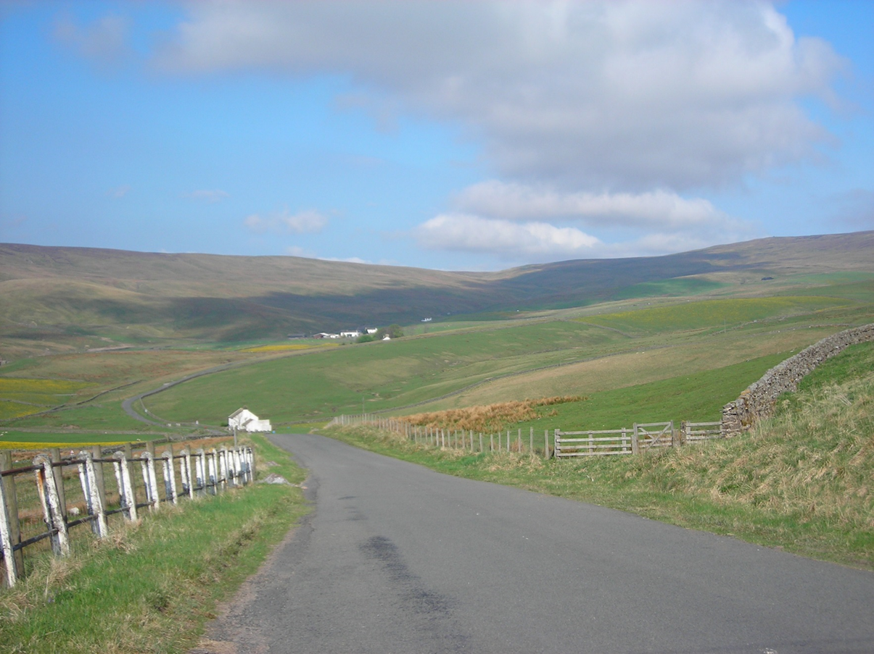
Why are we here?
Notes:
Another beautiful landscape picture here, again illustrating our heartland of upper Teesdale, sunny, good weather for work, easy to get around, blue skies…. But on other days everything can be very different…

Slide 4
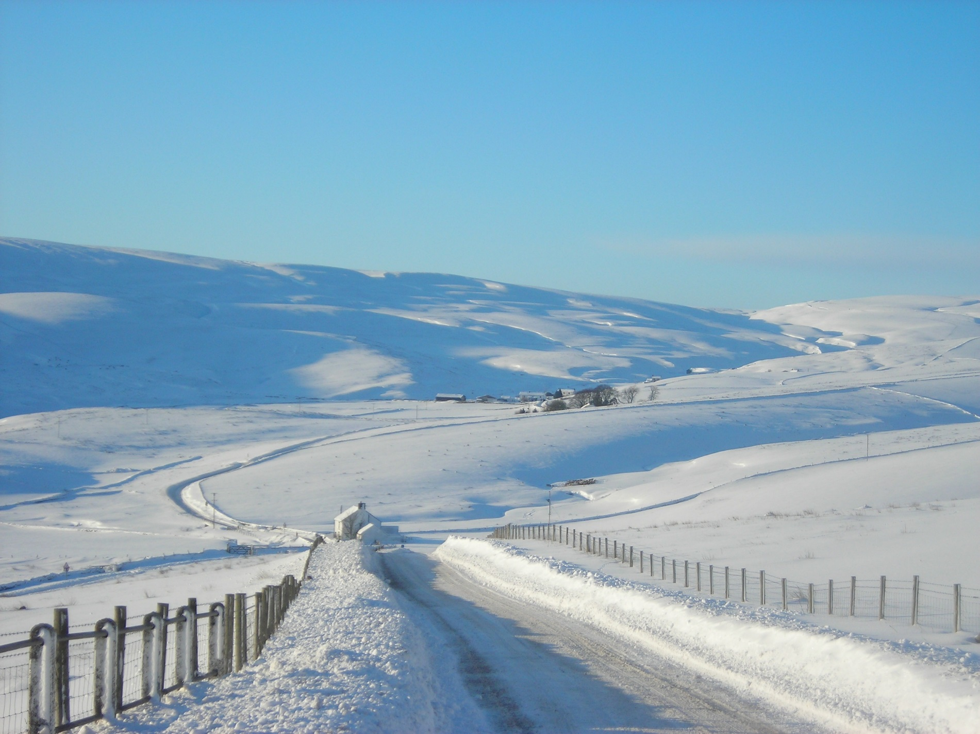
Why are we here?
Notes:
So here in Harwood, when the weather turns, the effects can be felt for some time… small roads, tracks to farms and cottages, significant distance to neighbours
Of course this is the kind of area that is one of the ones across our region that has been hit significantly by Storm Arwen, with houses here being without power connection for 9 days and still many on temporary generators at present

Slide 5
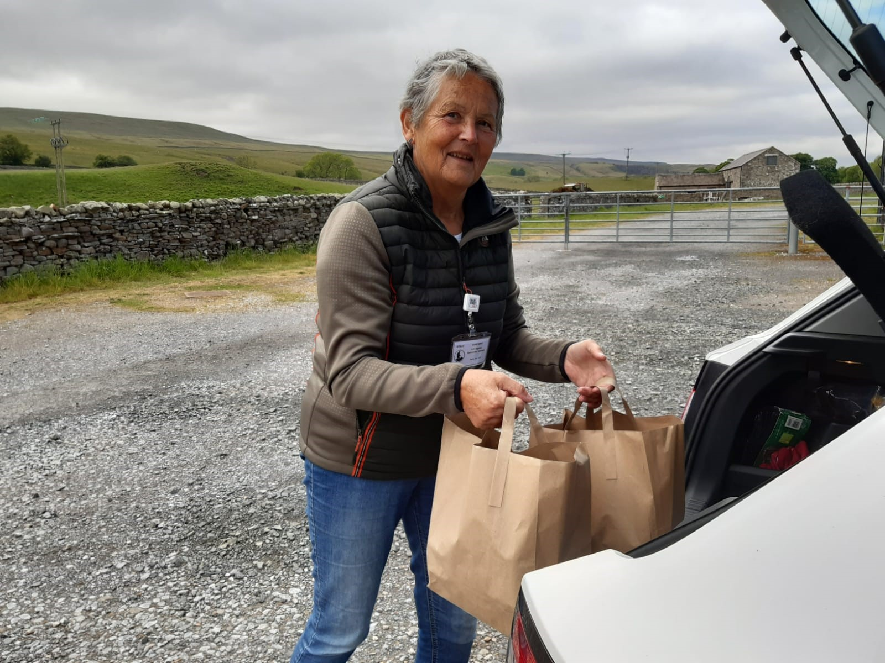
Notes:
In March 2020, we held our final Cree lunch of the year face to face before Covid-19 stopped the sessions.
We were conscious that a number of people who attend the cree sessions would struggle, not just due to the fact that our sessions could not go ahead, but also that other community sessions had ceased and they couldn’t get out of their homes to see people or access cooked food.
Through our in It Together campaign, we recruited over 100 volunteers to help with various activities and one of these was weekly meal deliveries to people living across upper Teesdale and Weardale who needed additional support.
We spoke with each of our members to determine the support needed based on their individual circumstance and Anne, our Cree champion has then spoken with members on a weekly, bi-weekly or monthly basis depending on their agreed needs.
A local caterer volunteered to cook meals, at Middleton Mart café, and other volunteers signed up to do doorstep deliveries and we have now been offering a delivery service since last April--- which continues today for those who cannot get out and about and have a need for this support

Slide 6
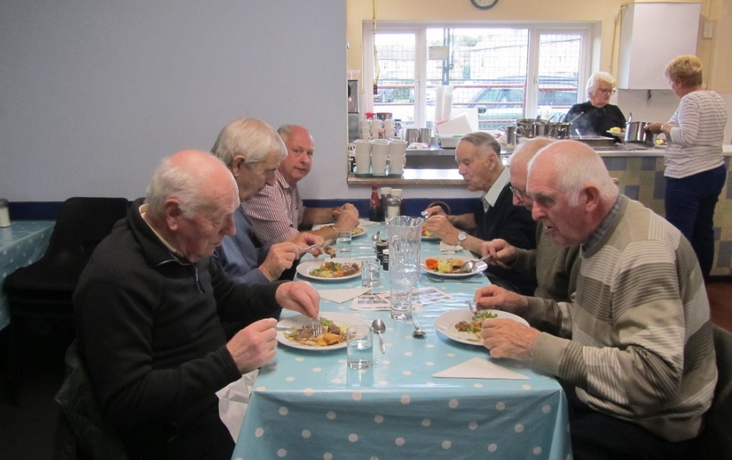
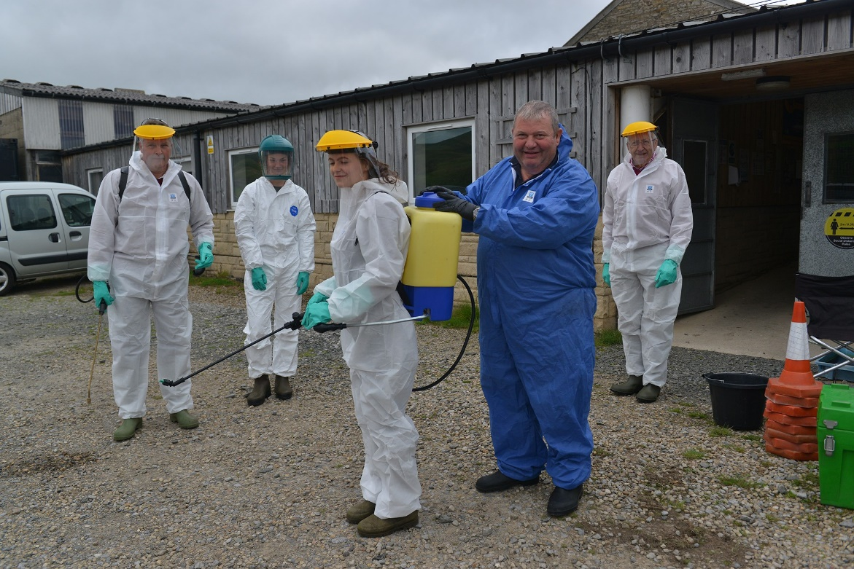
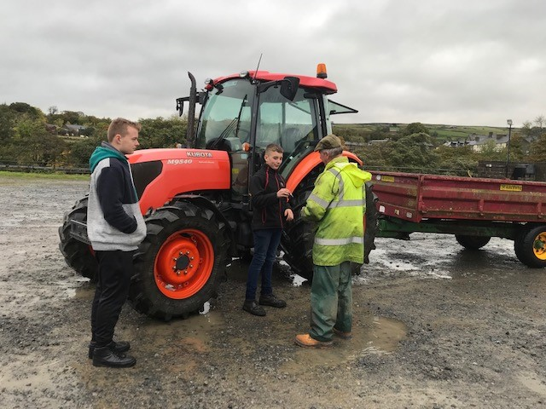
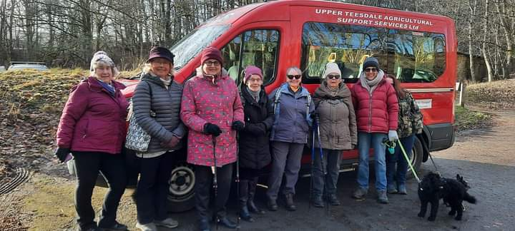
Notes:
In March 2020, we held our final Cree lunch of the year face to face before Covid-19 stopped the sessions.
We were conscious that a number of people who attend the cree sessions would struggle, not just due to the fact that our sessions could not go ahead, but also that other community sessions had ceased and they couldn’t get out of their homes to see people or access cooked food.
Through our in It Together campaign, we recruited over 100 volunteers to help with various activities and one of these was weekly meal deliveries to people living across upper Teesdale and Weardale who needed additional support.
We spoke with each of our members to determine the support needed based on their individual circumstance and Anne, our Cree champion has then spoken with members on a weekly, bi-weekly or monthly basis depending on their agreed needs.
A local caterer volunteered to cook meals, at Middleton Mart café, and other volunteers signed up to do doorstep deliveries and we have now been offering a delivery service since last April--- which continues today for those who cannot get out and about and have a need for this support

Slide 7
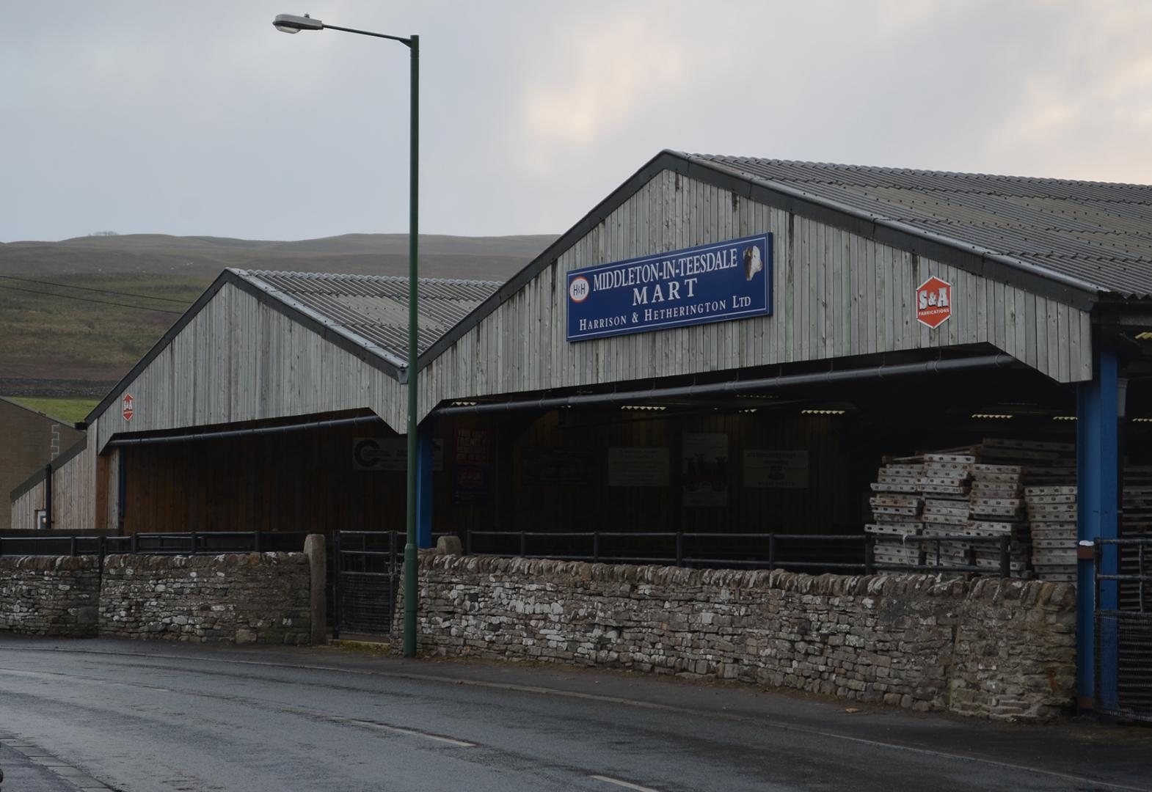
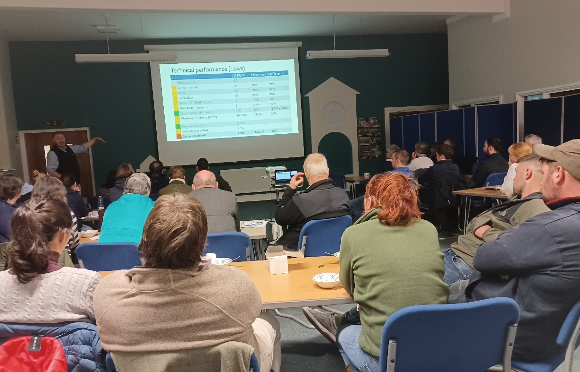
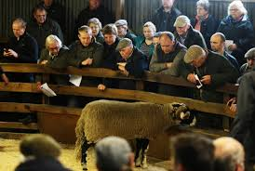
Notes:
In March 2020, we held our final Cree lunch of the year face to face before Covid-19 stopped the sessions.
We were conscious that a number of people who attend the cree sessions would struggle, not just due to the fact that our sessions could not go ahead, but also that other community sessions had ceased and they couldn’t get out of their homes to see people or access cooked food.
Through our in It Together campaign, we recruited over 100 volunteers to help with various activities and one of these was weekly meal deliveries to people living across upper Teesdale and Weardale who needed additional support.
We spoke with each of our members to determine the support needed based on their individual circumstance and Anne, our Cree champion has then spoken with members on a weekly, bi-weekly or monthly basis depending on their agreed needs.
A local caterer volunteered to cook meals, at Middleton Mart café, and other volunteers signed up to do doorstep deliveries and we have now been offering a delivery service since last April--- which continues today for those who cannot get out and about and have a need for this support

Slide 8
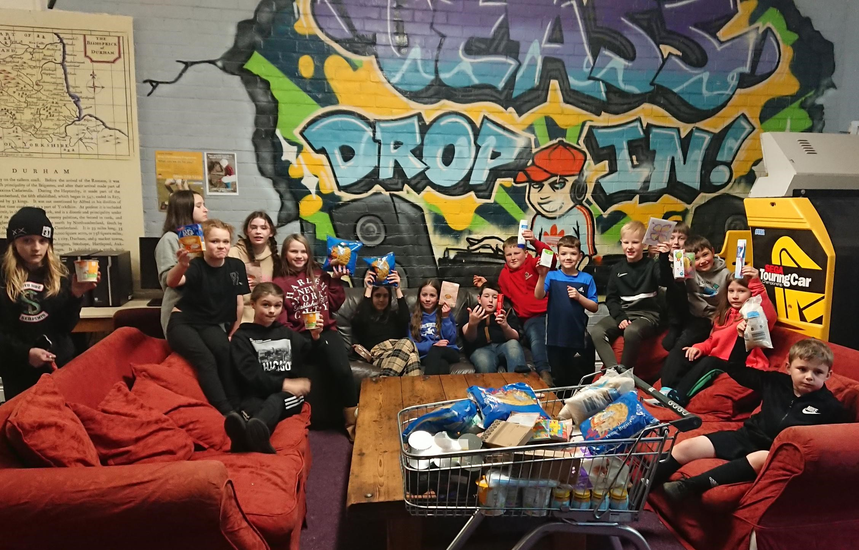
Notes:
Our Cree plus programme which is now underway has enabled us to augment our delivery, with some additional coffee and chat type sessions, some games box resources for members to use at sessions and some day trips to help people take the next step to perhaps get out and about again, using the UTASS Minibus

Slide 9
Get in Touch… Grace Crawford Funding & Strategic Development Officer 07462 855431 grace@utass.org
Notes:
I’m happy to take any questions,
If anyone would like to set up a follow up meeting or to come up for a visit to find out more about UTASS and the work that we do I would be more than happy to arrange, so please do get in touch

