Slide 1
Poverty Action Strategy and Action Plan
Consultation
June 2022
Mary Readman, Head of Transactional and Customer Services

Slide 2
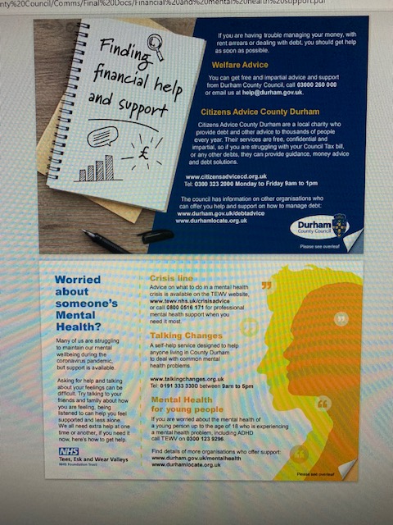
Background
Poverty Action strategy and plan for County Durham since 2014 and reviewed regularly
2020 review broadened the scope to include the immediate impacts of the COVID-19 pandemic and deliver targeted interventions with the aim:
“to improve the standard of living and daily lives of those residents in County Durham who are currently experiencing immediate financial hardship due to the COVID-19 pandemic and associated economic shocks; and to help alleviate long term issues that can lead households on low incomes to experience financial pressures and poverty”

Slide 3
Partnership working has been key....
Advice in County Durham Partnership - referral portal, partnership training
Social landlords - DHPs
Private landlords – ‘stop before you serve’
Schools – food vouchers for FSM eligible children, poverty proofing the school day
Partners working with families and children – Covid Winter Grant/Local Covid Support/Household Support Fund etc.
Holiday Activities with food programme
Partners identifying vulnerable households and administering support – food/fuel
GPs – Warm Homes referrals
Health Visitors – Healthy Start voucher take up
Foodbanks – grant funding, DCC staff volunteers
The Bread and Butter Thing – grant funding
Community Groups and AAPs – holiday activities with food programme and bespoke community initiatives/projects
Credit Union – promoting safe credit and a savings culture
…. AND MANY MORE!

Slide 4
Emerging issues…
‘Cost of living crisis’:
Wages forecasted to fall in real terms (after inflation) this year and next
National Insurance increase
Highest recorded levels of inflation since 1992
Food prices rising at quickest rate in a decade
Increase in household energy costs as a result of increased wholesale prices and an increase in the domestic energy price cap
Increased fuel costs for drivers and increased public transport costs
Increases in the costs of consumer goods such as white goods and furniture due to supply chain bottlenecks and rising inflation
Equals =
Increased demand for financial support from the council
Increased demand for support from partners
New cohorts of residents requesting support for the first time

Slide 5
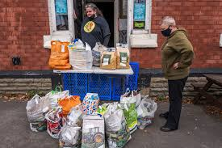
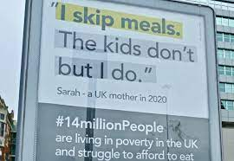
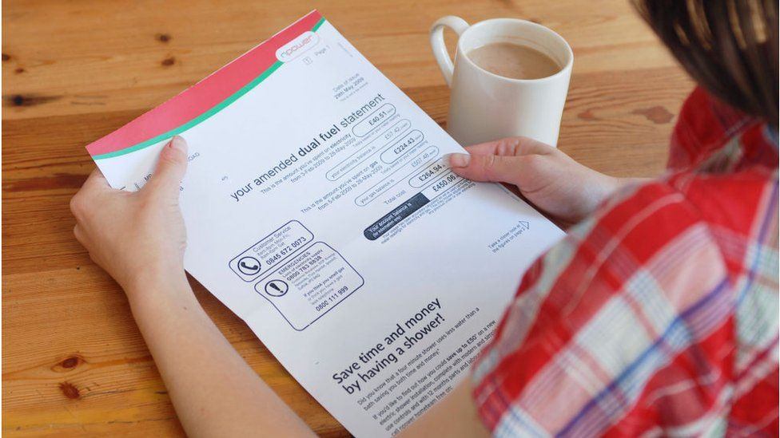
…. challenges
Increase in levels of poverty
Changing access to services
Impact on volunteering
Increased complexity of need
Comms: Need for good, easily accessible information on provision
Focus on areas we need to improve (customer journey)
Improving data sharing
Building on what's in place....innovating through collaboration
Organisations returning pre-COVID service levels at different times
Yet unknown post-COVID issues/’cost of living crisis’ impacts

Slide 6
Where we are now…
Current review identifies opportunities for additional preventative work to prevent households getting into financial difficulties
Builds on where we’ve been and where we want to get to:
Embraced new ways of working
Rapid responses
Collaboration between services
Good information about our communities
Sense of public confidence in what we were delivering
Voluntary sector partnerships delivered in the main
Community spirit came to the forefront

Slide 7
Thrive Model

Slide 8
Inclusive economic strategy
Communities and businesses asked to play a crucial role in developing an inclusive and pioneering economic strategy through “Our Big Econ-versation”
New strategy developed which aims to:
build on our strengths
ensure people and places are at the heart of all future plans
rebuild a powerful economy
Summer 2022 – consultation on the draft strategy
Late Autumn 2022 – launch County Durham’s Inclusive Economic Strategy

Slide 9
Revised strategy and action plan
Vision: To work together with communities so fewer people will be affected by poverty and deprivation in the county
Objective 1: Use intelligence and data to target support to low-income households
Objective 2: Reduce the financial pressures on people facing or in poverty
Objective 3: Increase individual, household and community resilience to poverty
Objective 4: Reduce barriers to accessing services for those experiencing financial insecurity

Slide 10
Group discussion
Are these the right objectives?
Where are the gaps/what more do we need to do?
Are there any groups of people missing?
Strategy and action plan available online
Feedback and comments before 26 August 2022 via
https://online1.snapsurveys.com/Poverty or
Email: povertyaction@durham.gov.uk

Slide 11
Next steps
May-August 2022 – consultation with key partners and stakeholders
September 2022 – strategy and action plan finalised
November 2022 – Cabinet approval
November 2022 > - delivery

