Slide 1
Better Together Policy Forum
Amanda Healy
Director of Public Health
Regional Perspective Health Inequalities and the Integrated Health System

Slide 2
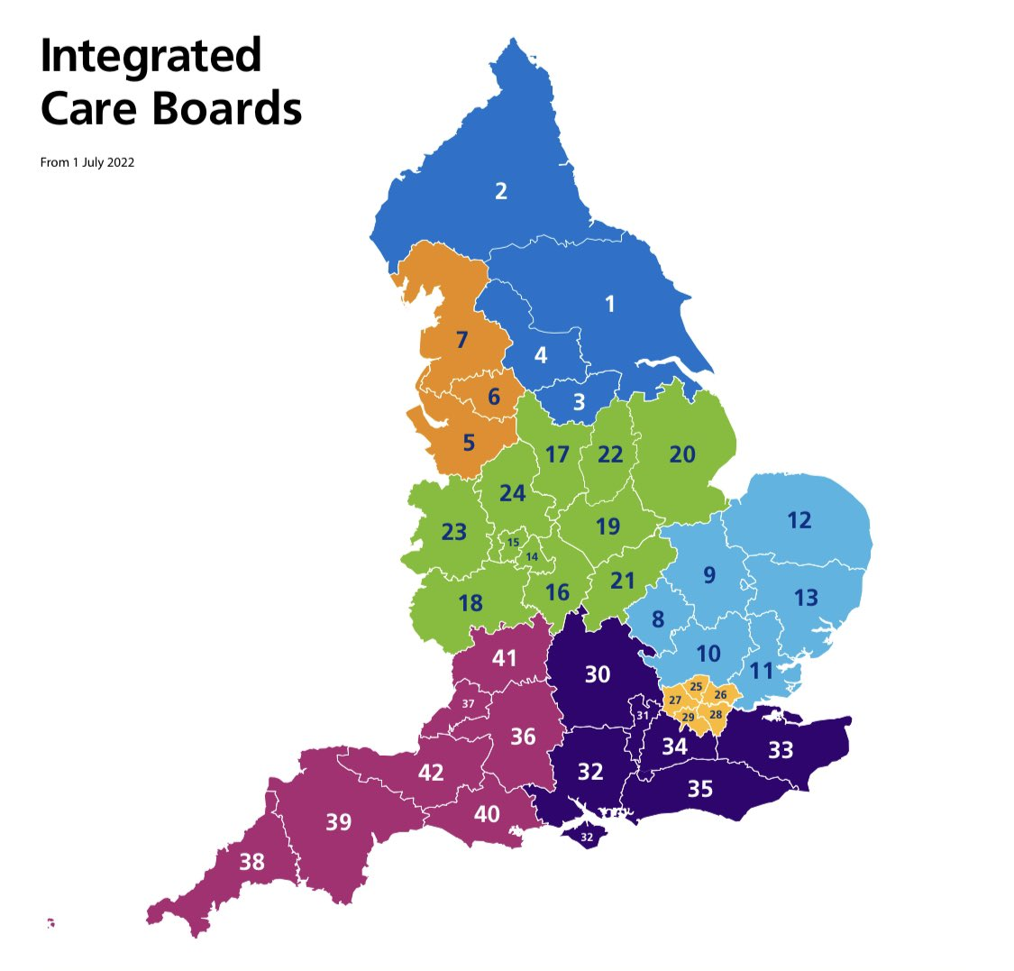
What is an ICS, ICB and ICP?
Integrated Care System (ICS) – includes all of the organisations responsible for health and wellbeing working together across a region to plan and deliver services for our communities.
It is not an organisation but works through the following bodies:
Integrated Care Board (ICB) – a statutory NHS organisation that took on the responsibilities of the former CCGs and some of the functions held by NHS England. The ICB will also work with a range of partners at ‘place level’ in each of the 14 local authority areas in our region.
Integrated Care Partnership (ICP) – a joint committee of the ICB and the 14 local authorities in the ICS area – plus other invited partners - responsible for developing an integrated care strategy for the ICS.
42 Integrated Care Boards established across England from 1 July 2022 – replacing the former CCGs

Slide 3
Strategic aims of ICBs set by government
Continue to raise standards so services are high quality and delivered effectively making sure everyone has access to safe quality care whether in the community or in another setting.
Maximise the use of evidence-based tools, research, digital solutions and techniques to support our ambition to deliver better health and wellbeing outcomes in a way that meets the different needs of local people.
Working with partners in NHS, Social Care, and Voluntary and Community Sector organisations at scale on key strategic initiatives where it makes sense to do so. Harnessing our collective resources and expertise to invest wisely and make faster progress on improving health outcomes.
Focus on improving population health and well-being through tackling the wider socio-economic determinants of health that have an impact on the communities we serve.
1
2
3
4
Improve outcomes in population health and healthcare
Tackle inequalities in outcomes, experience and access
Enhance productivity and value for money
Help the NHS support broader social and economic development

Slide 4
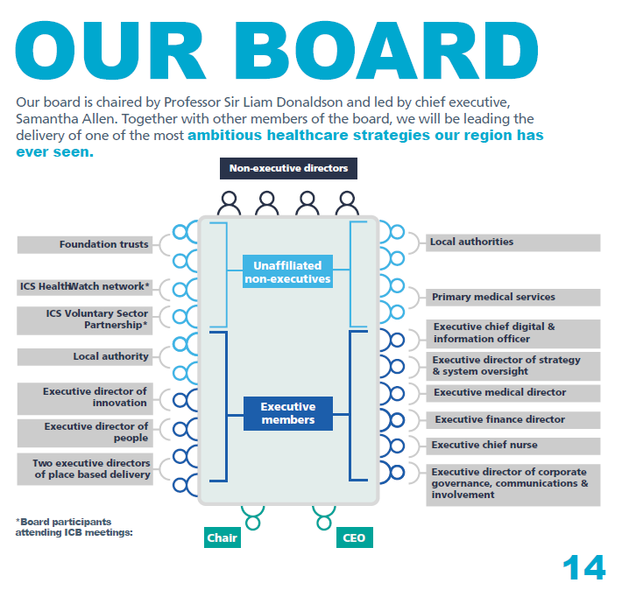
ICB leadership team
ICB Chair – Sir Liam Donaldson
ICB Chief Executive – Samantha Allen
ICB Partner Members
Local Authorities: Cllr Shane Moore (Hartlepool), Tom Hall (South Tyneside), Ann Workman (Stockton-on-Tees), Cath McEvoy-Carr (Newcastle),
Primary Care: Dr Saira Malik (Sunderland), Dr Mike Smith (County Durham)
NHS Foundation Trusts: Ken Bremner MBE (NHS South Tyneside and Sunderland Foundation Trust), Dr Rajesh Nadkarni (NHS Cumbria, Northumberland and Tyne & Wear Foundation Trust)
ICB Non Executive Directors
Dr Hannah Bows
Prof Eileen Kaner
Jon Rush
David Stout OBE
ICB Participants
ICS HealthWatch Network: TBC
ICS Voluntary Sector Partnership: Jane Hartley
ICB Executive Directors
Executive Medical Director – Dr Neil O'Brien
Executive Chief Nurse – David Purdue
Executive Director of People – Annie Laverty
Executive Director of Finance – David Chandler
Executive Chief of Strategy and Operations – Jacqueline Myers
Executive Director of Corporate Governance, Communications & Involvement – Claire Riley
Executive Chief Digital and Information Officer – Professor Graham Evans
Executive Director of Innovation – Aejaz Zahid
Executive Director of Placed Based Partnerships (North and North Cumbria) – Levi Buckley
Executive Director of Placed Based Partnerships (Central & Tees Valley) – Dave Gallagher

Slide 5
ICB Governance Framework
Integrated Care Board
Strategic Integrated Care Partnership
North East and North Cumbria Local Authorities
Audit Committee
Remuneration Committee
Executive Committee
North Cumbria Area Integrated Care Partnership
North Area Integrated Care Partnership
Health and Wellbeing Boards
Finance, Performance and Investment Committee
Quality and Safety Committee
Central Area Integrated Care Partnership
Tees Valley Area Integrated Care Partnership
ICB sub-committees
ICB sub-committees
North Cumbria Area Quality and Safety Sub Committee
North Area
Quality and Safety
Sub-committee
Central Area
Quality and Safety
Sub-committee
Individual Funding Request Panel South
(Sub-committee)
Individual Funding Request Panel North
(Sub-committee)
Healthier and Fairer Advisory Group
(Sub-committee)
People Board
(Sub-committee)
Primary Care Strategy and Delivery (Sub-committee)
Medicines Optimisation
(Sub-committee)
Safeguarding Sub-committee
Antimicrobial Resistance and Healthcare Associated Infections Sub-committee
South Area
Quality and Safety Sub-committee
Pharmaceutical Services Regulatory Sub-Committee
[Name] Place Sub-committees
Mental Health, Learning Disabilities and Autism
Sub-committee
Value Based Steering Group
(Sub-committee)
Colour codes:
Formally established by the ICB
In development –
not yet formally established by the ICB
Joint with local authorities
Local authority structures

Slide 6
Prevention Board to Healthier and Fairer Advisory Group
Longstanding North East North Cumbria Prevention Board
Focus on adding value at a regional level, building on place
Clinical lead, manager and support
Tobacco, alcohol, healthy weight
Community assets and social prescribing
Broader remit for population health management, support to other networks such as cancer network and local maternity systems, MECC
Innovative approach e.g Consultants in Trusts, Reading for Wellbeing Coaches

Slide 7
Committee
Healthier and Fairer
NENC ICB Exec Committee
Business Support Group
Advisory Group
Healthier & Fairer Advisory Group Chairs Dr N O’Brien / Amanda Healy (DPH)
Workstreams
Prevention
Chairs Dr G Pilkington / Alice Wiseman (DPH)
Healthcare Inequalities
Chairs Dr R Hudson / Gerry Taylor (DPH)
NHS Contribution to Social & Economic Inequalities
Chairs Dr D Slowie / Mark Adams (DPH)
Alcohol
Tobacco
Obesity
CVD
Maternity
C20+5 CYP
C20+5
Waiting Well
Anchor Network
Poverty Proofing (Clinical Pathways)
Digital inclusion
Health Literacy
Workstream Programmes
DeepEnd
PLUS

Slide 8
Committee
Enabling Workstream Governance
NENC ICB Exec Committee
Business Support Group
Advisory Group
Healthier & Fairer Advisory Group
Chairs Dr N O’Brien / Amanda Healy (DPH)
Enabling Workstreams
Population Health Management
Chair Prof Kunonga
Community Asset Based Approach
Chair Jane Hartley
Workforce Development
Chair Hamid Motraghi

Slide 9
Healthy and Fairer Advisory Group
Summary of the first meeting of the group on the 23rd February 2023

Slide 10
Overview
The Healthy and Fairer Advisory Group has been established as a whole system means of supporting the ICP aim of better health and wellbeing for all our people and communities.
Jointly chaired by the ICB Executive Medical Director Neil O’Brien, and Chair of the Association of Directors of Public Health NE Network Amanda Healy, the group draws its membership from a wide range of system partners across the health, care, public health, research, and VCSE community, and reports into the ICB Executive.
The group oversees the delivery of a programme of work that encompasses Prevention, Healthcare Inequalities, and the NHS Contribution to Social and Economic Inequalities/

Slide 11
Representation on the Advisory Group
ICB Exec (Medical Directors / Finance / Governance)
Directors of Public Health
Association of Directors of Adult Social Services
Association of Directors of Childrens Services
ICB Place representatives
NHS Foundation Trusts
Office for Health Improvement and Disparities (OHID)
Healthwatch
Voluntary Organisations Network North East (VONNE)
Applied Research Collaborative (ARC)
NECS
North East Quality Observatory Service (NEQOS)
NHSE North East and Yorkshire Region

Slide 12
Summary of the first meeting
Review of the NHS planning requirements and forthcoming submissions, including the ICB Joint Forward Plan
Updates from the 3 workstreams as they establish their individual workplans
Recent NHS Healthcare Inequalities stocktake submission
Paper on Vaccine Inequalities programme detailing projects across all NENC Local Authorities and ICB-wide projects

Slide 13
Prevention workstream
Priorities
Approach
Tobacco
Alcohol
Obesity
CVD
Public health prevention in maternity
Clinical lead
OHID
DPH / CPH
Evidence based
Demonstrating impact

Slide 14
Healthcare Inequalities Group Development Session 20th March 2023
Aims
Have got to know each other
Set out H&F Programme and HCI Group
Defined our common purpose through Co-designing the aims, scope and reach of our programme
Explored how we will share and learn from each other
Agreed how we measure our progress
Explored how to influence and support the system

Slide 15
Health Inequalities Funding Allocation and existing prevention funding
Healthy communities and social prescribing
Plus programme
Tobacco control
Health literacy
Maternity systems
Poverty proofing
Accelerating prevention programmes – tobacco, alcohol, healthy weight

Slide 16
Healthy Communities and Social Prescribing (enabling workstream of H&F structure)
Due to over subscription and high interest, this group will now operate a 2 tier structure – a network group to share practice and key information will be held bi-annually and a smaller focused steering group will be established to meet quarterly
VCSE infrastructure funding – small working group under Healthy Communities and Social Prescribing workstream met to score EOIs received from VCSE infrastructure organisations in each local authority area. This funding is to be allocated at place based on IMD and population pro rata calculations and is to support targeted work to build local VCSE capacity in delivering social prescribing activity and support and strengthen connections with social prescribing link workers and leads locally to foster greater collaboration.

Slide 17
Healthy Communities and Social Prescribing (enabling workstream of H&F structure)
Core20Plus5 Connectors programme – NENC part of wave 1 sites in receipt of national NHSE/I funding to invest and support community connectors to support the Core20Plus5 agenda and improved outcomes. The NENC approach is to build on the established community champion programmes within our local authorities. The programme has achieved the following:
Recruitment of Project Manager hosted by VONNE to support capacity
Establishment and bi-monthly meetings of regional network of LA leads responsible for champion programmes to share practice and look at areas to collaborate regionally
Peer led approach working with Middlesbrough and Gateshead to share and learn existing practice
Focus on cancer champions as one of the 5 Core20 clinical areas and successful roll out of Gateshead cancer champion model into Middlesbrough
Practice sharing event held in March with multiagency representation from across the ICS with a focus on exploring how champion approaches can further support the Core20Plus5 agenda
Development of online champion knowledge exchange to share practice and case study examples
Reading for Wellbeing project – following a celebration event in February to share the impact and lessons learned from the pilot year of the project, a further 6 LA areas have expressed interest to establish a project and are taking this forward locally

Slide 18
Next steps
Further develop new ways of working
Respond to Hewitt Review
Ensure join up between local and regional is clear
Alignment of the ICP strategy and its ambitions
Always build from place

Slide 19
Local Perspective Durham’s Place in the ICS
Sarah Burns
Director of Place
Integrated Strategic Commissioning

Slide 20
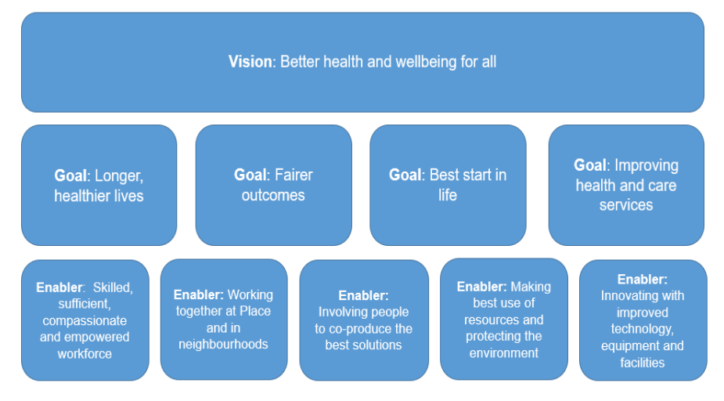
County Durham as Part of the Integrated Care Board and the Integrated Care System
Quick Recap
Integrated Care Board – statutory organisation
Integrated Care System – all organisations responsible for health and wellbeing working together

Slide 21
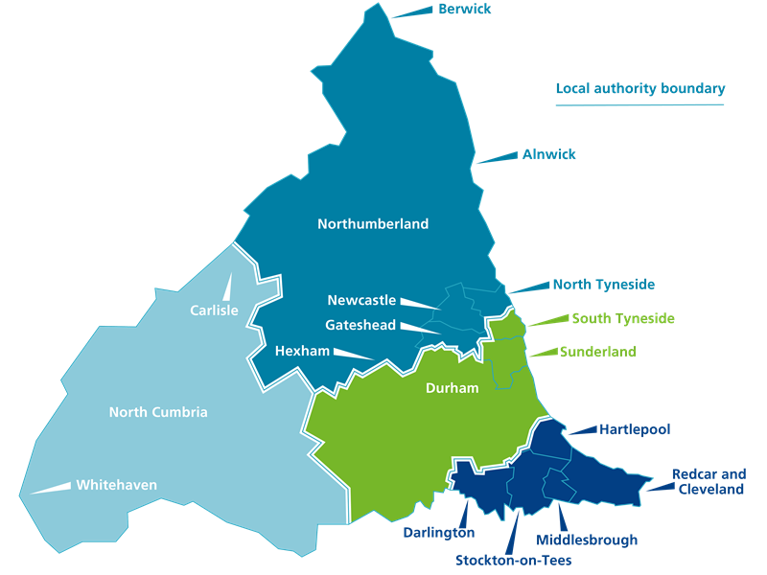
County Durham as Part of the Integrated Care Board and the Integrated Care System
Quick Recap
NENC population c3m
ICB divided into 4 partnerships – ICPs
County Durham is part of the Central partnership
County Durham represents 1/5 of the population

Slide 22
What is different about Durham
Strength of our partnerships
System wide partnerships like CDP and sub groups like Better Together
County Durham Care Partnership
Integrated working
Number of senior joint appointments – increasing
Well developed governance – preparing us for the formation of a joint committee

Slide 24
Our priorities
JSNAA
JLHWS
ICB plan, but most importantly our local plan
County Durham plan to be signed off by HWBB in June 2023
Starting well
Living well
Ageing well
Enabling functions

