Slide 1
An Introduction to DCP
Peter MacLellan
CEO

Slide 2
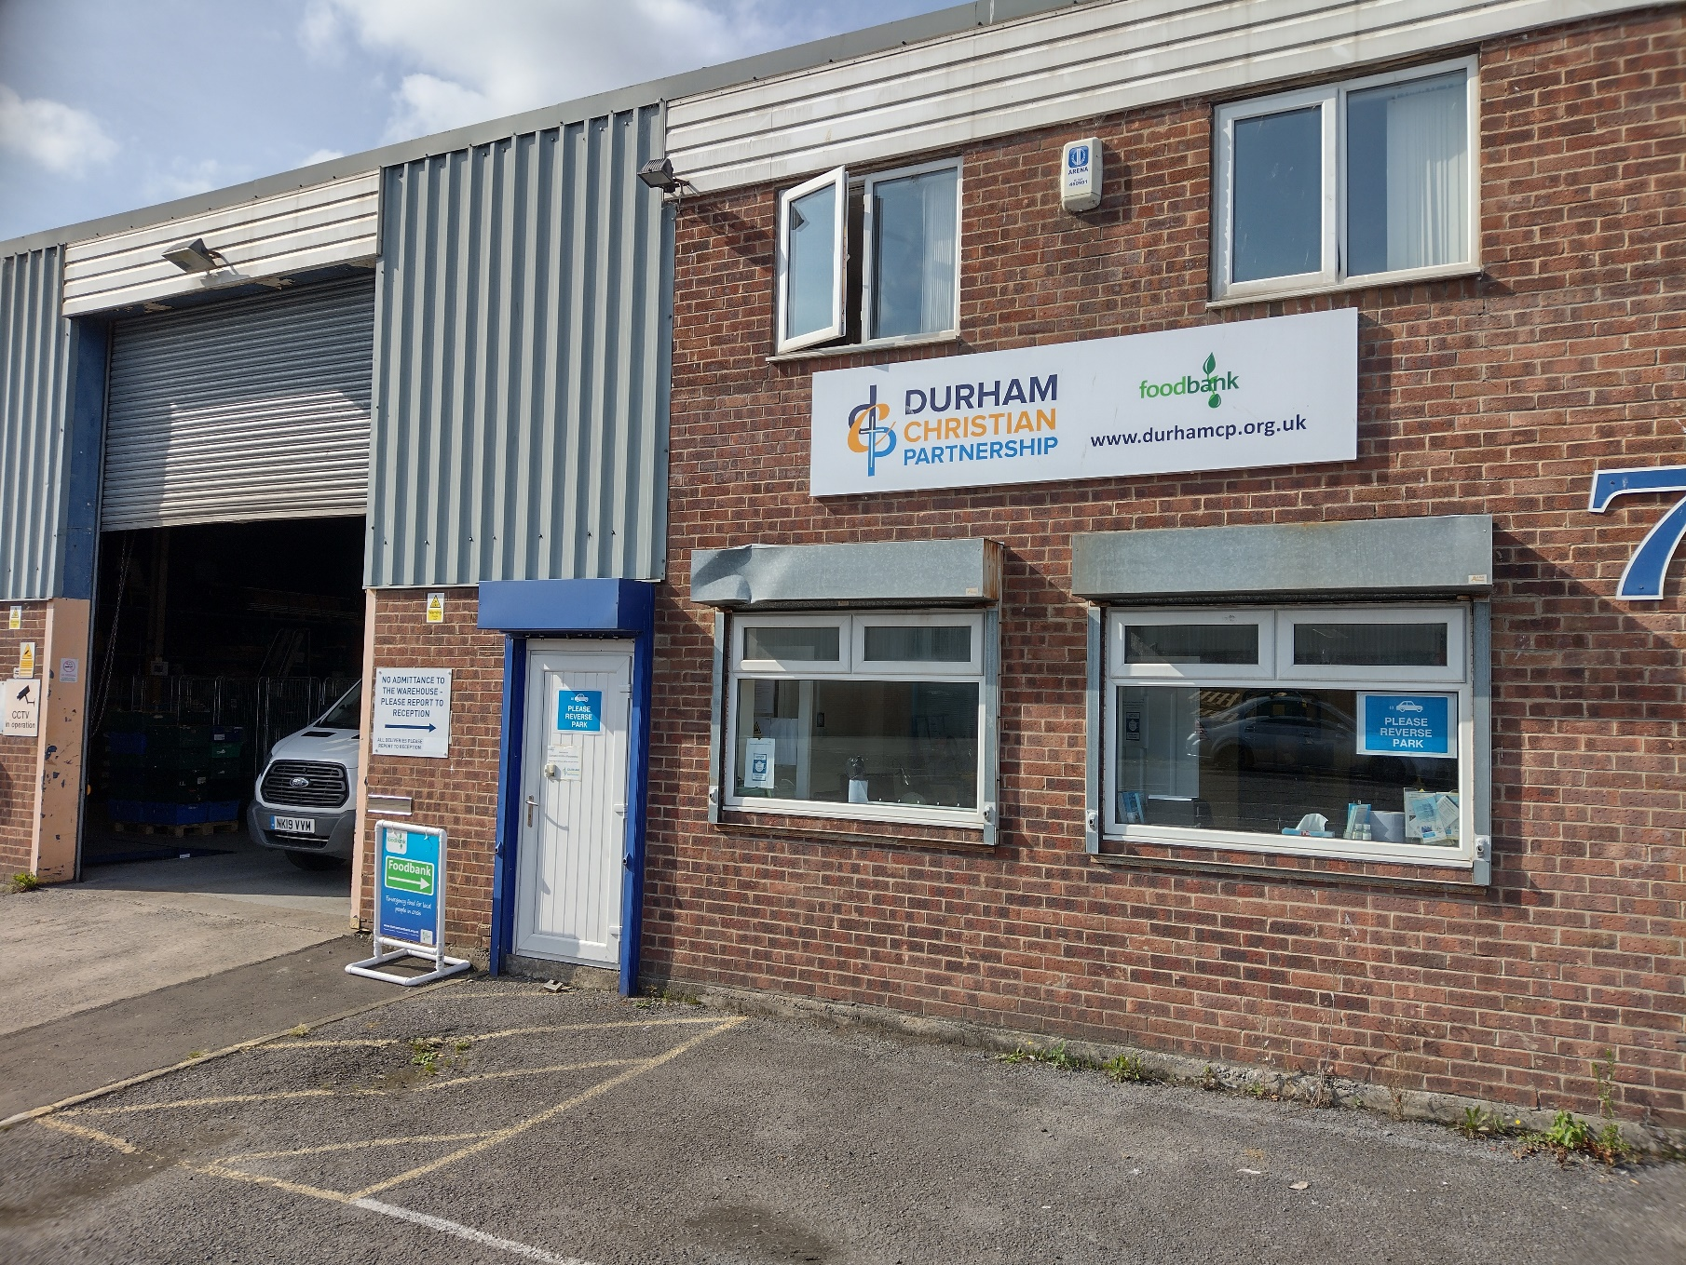
Our People & Places
Currently 28 Staff
Approximately 400 volunteers
Operating out of 40 sites
Main office
Unit 7/9 First Avenue
Drum Industrial Estate,
Chester-le-Street
DH2 1AG

Slide 3
Our Projects
County Durham Foodbank
Sunderland Foodbank
Fuel Bank
Community Money Advice County Durham
PAD B (Push A Different Button)
School Mentoring
Refugee Support
StreetLights
Grandparents Support Group
Community Shop

Slide 4
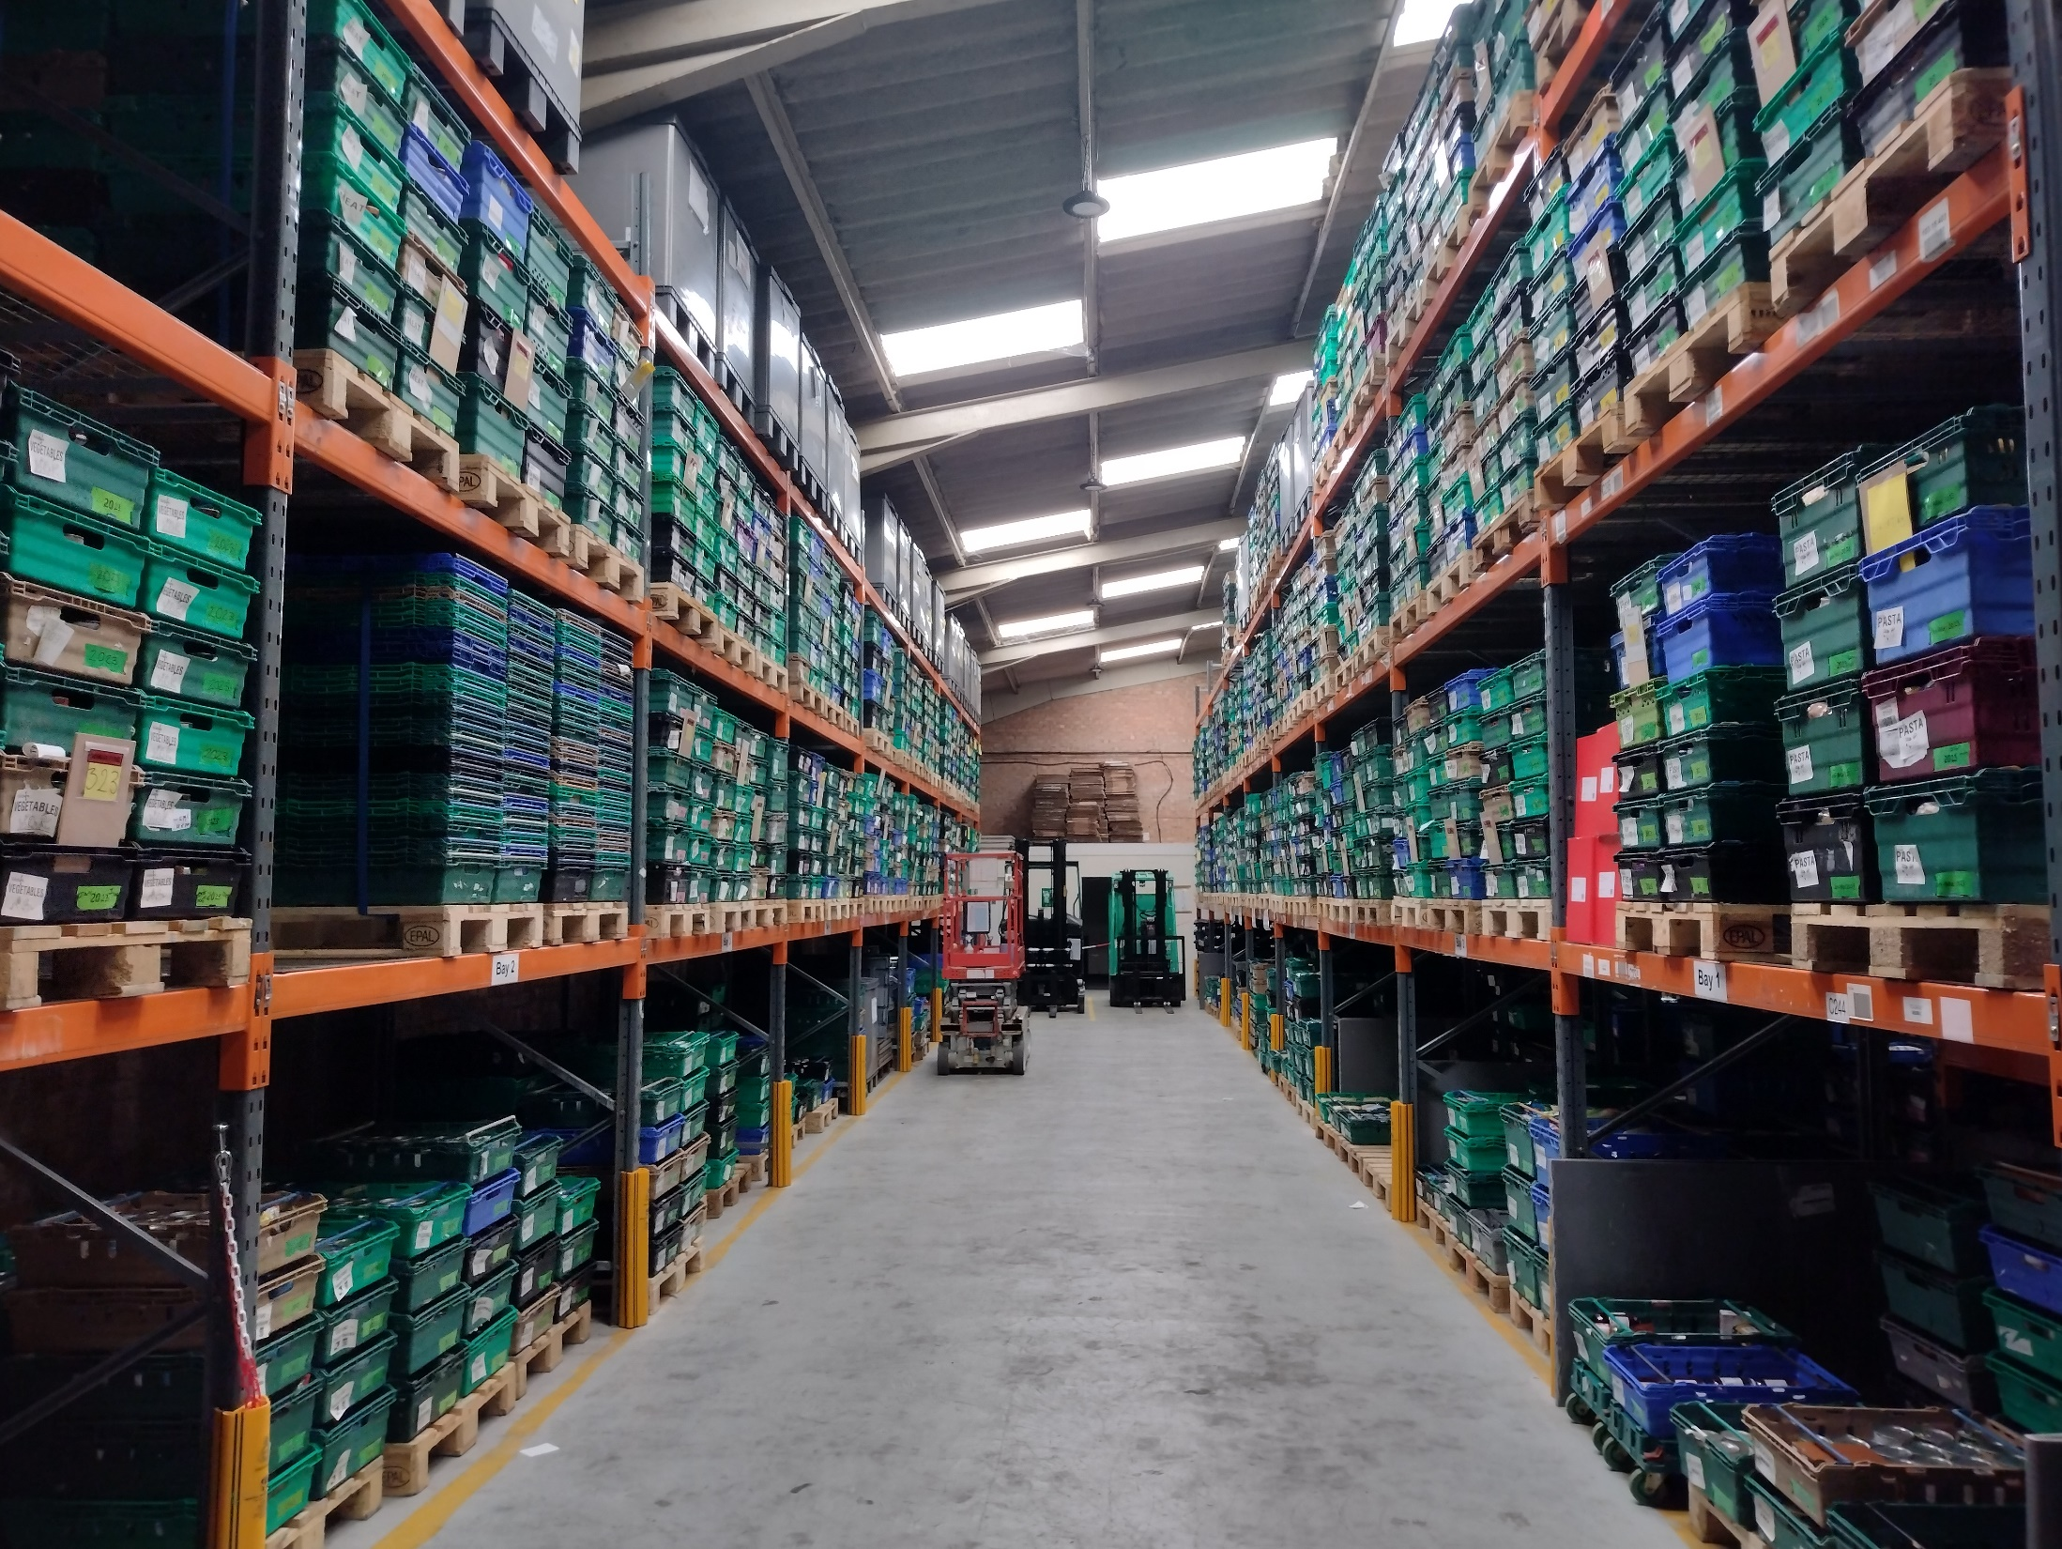
Operating since 2011 (2018 Sunderland)
Collecting and distributing over 220 tonnes of food a year
Feeding over 30,000 people a year

Slide 6
Foodbank
Referral by telephone generates a code
Information collected on applicant’s situation
Referral to other support and advice?
36 Distribution Points (28 in County Durham, 8 in Sunderland)
3 Days food per person
Access to Vodafone SIM cards
Access to Fuel vouchers for people on prepayment meters
Further signposting to other advice or support

Slide 7
CMA County Durham
Free regulated debt advice
Full face to face service – including at home if required
7 Advisers plus 2 case support workers
Debt Relief Orders, Bankruptcy, Payment Plans
Refer via AinCD or direct

Slide 8
PAD B (Push A Different Button)
Chester-le-Street area
Drug, alcohol or mental health issues
Peer support community
Activities – outdoor and indoor
Ladies and men’s groups
Mentoring and support in accessing professional services
Open ended

Slide 9
Smaller Projects
Refugee Support – SIMs, food and household goods
School mentoring – Mentors for children referred by schools
StreetLights – support on Saturday nights in Durham
Grandparents Support – Peer support for those who have lost contact with their grandchildren – meets in Durham
Community Shop – Front Street, Framwellgate Moor – clothes, household items and much more. New and used.

Slide 10
Contacts
DCP General
office@durhamcp.org.uk
0191 303 8623
Foodbank
office@durhamfoodbank.org.uk
0191 303 7559
CMA County Durham
office@moneyadvicedurham.org.uk
0191 303 7514
Website: www.durhamcp.org.uk

