Slide 1
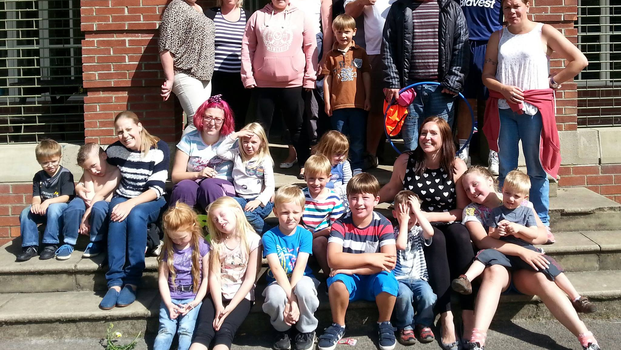
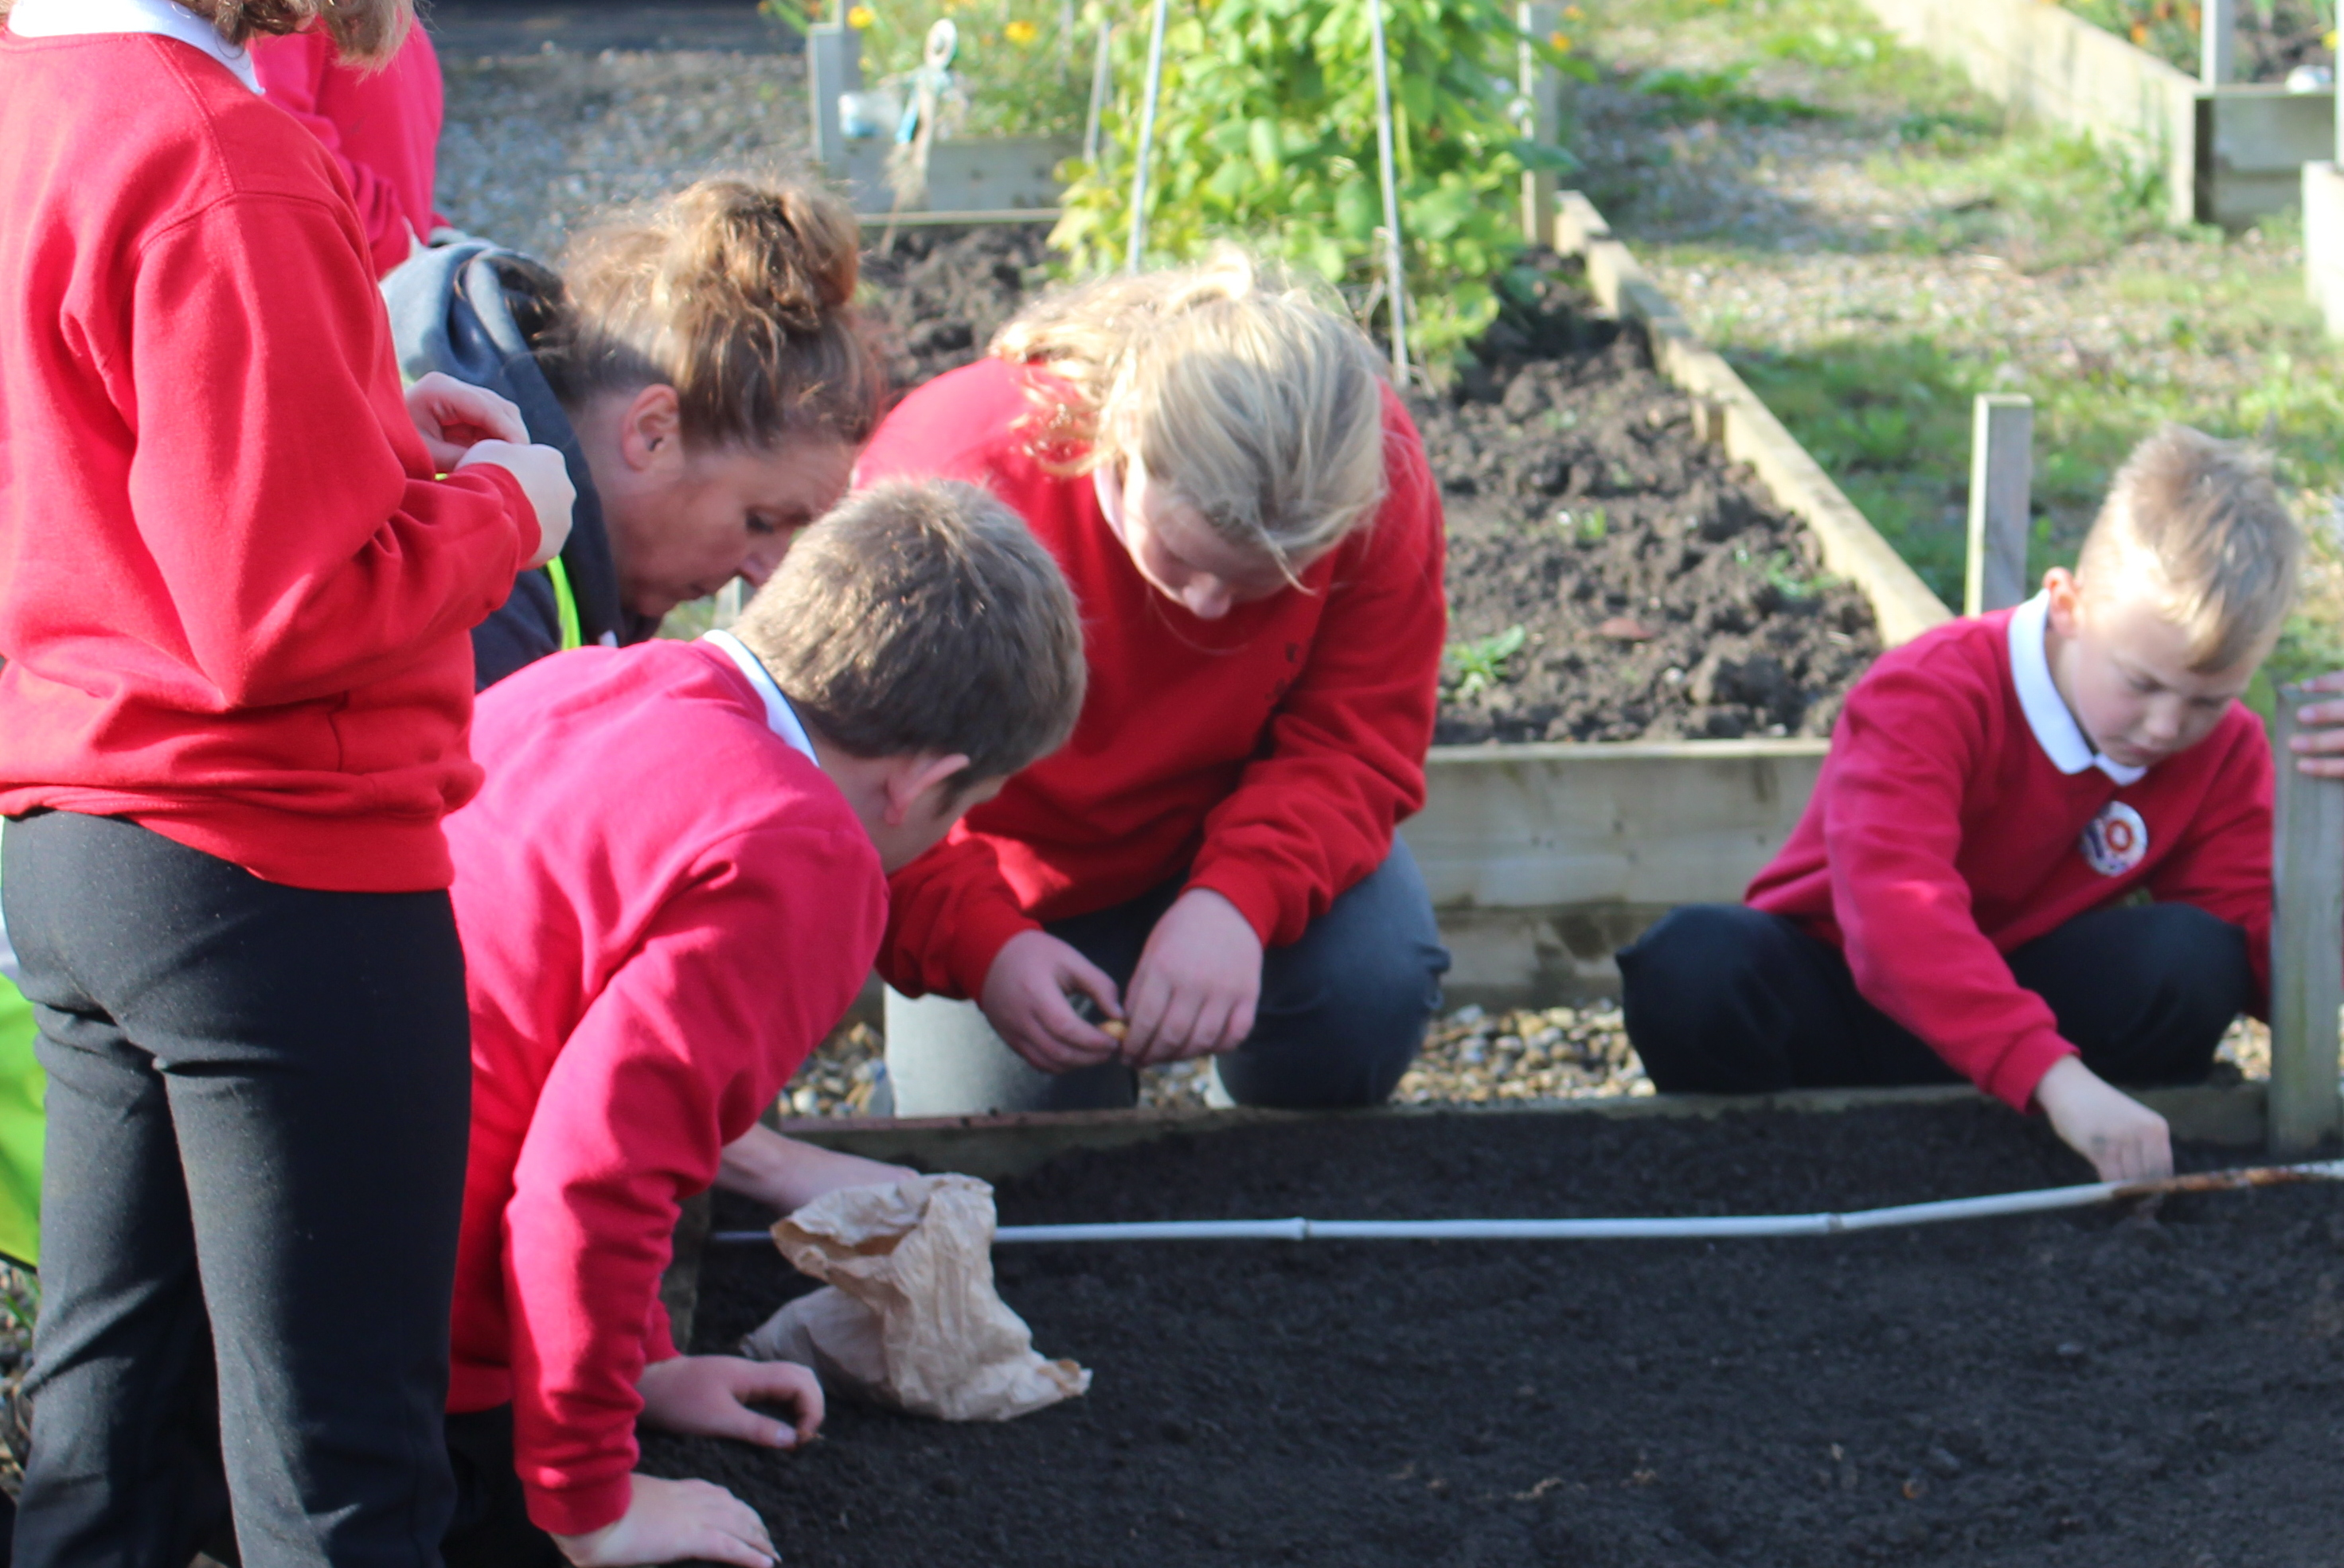
The role Community organisations like Shildon Alive play in their local system
Keep it Local

Slide 2
Relationships
Building trusting relationships with people who might not usually access services

Slide 3
Investment into local area

Slide 4
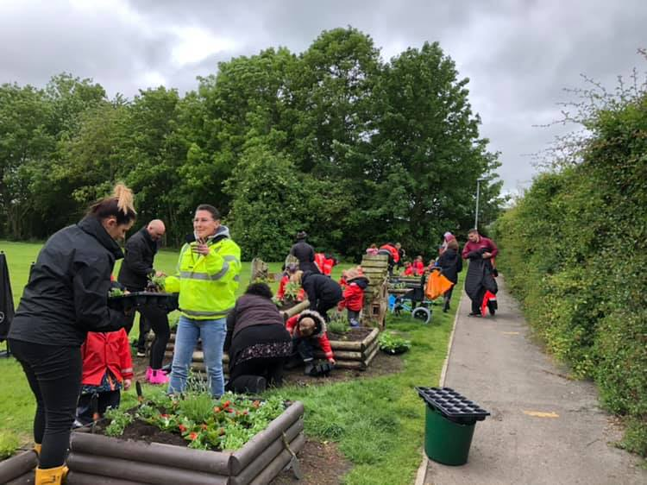
Local Investment
Starting off with one member of staff and a group of enthusiastic volunteers from the community, Shildon Alive brought much needed grant funding to the area,2 new paid roles were created as they became embedded in the community. Grant funding was also secured for improving areas in the town through Guerrilla Gardening and free community events.

Slide 5
Connections
Over the past 10 years we have made lasting connections with many partner organisations.
We work together to support our communities

Slide 6
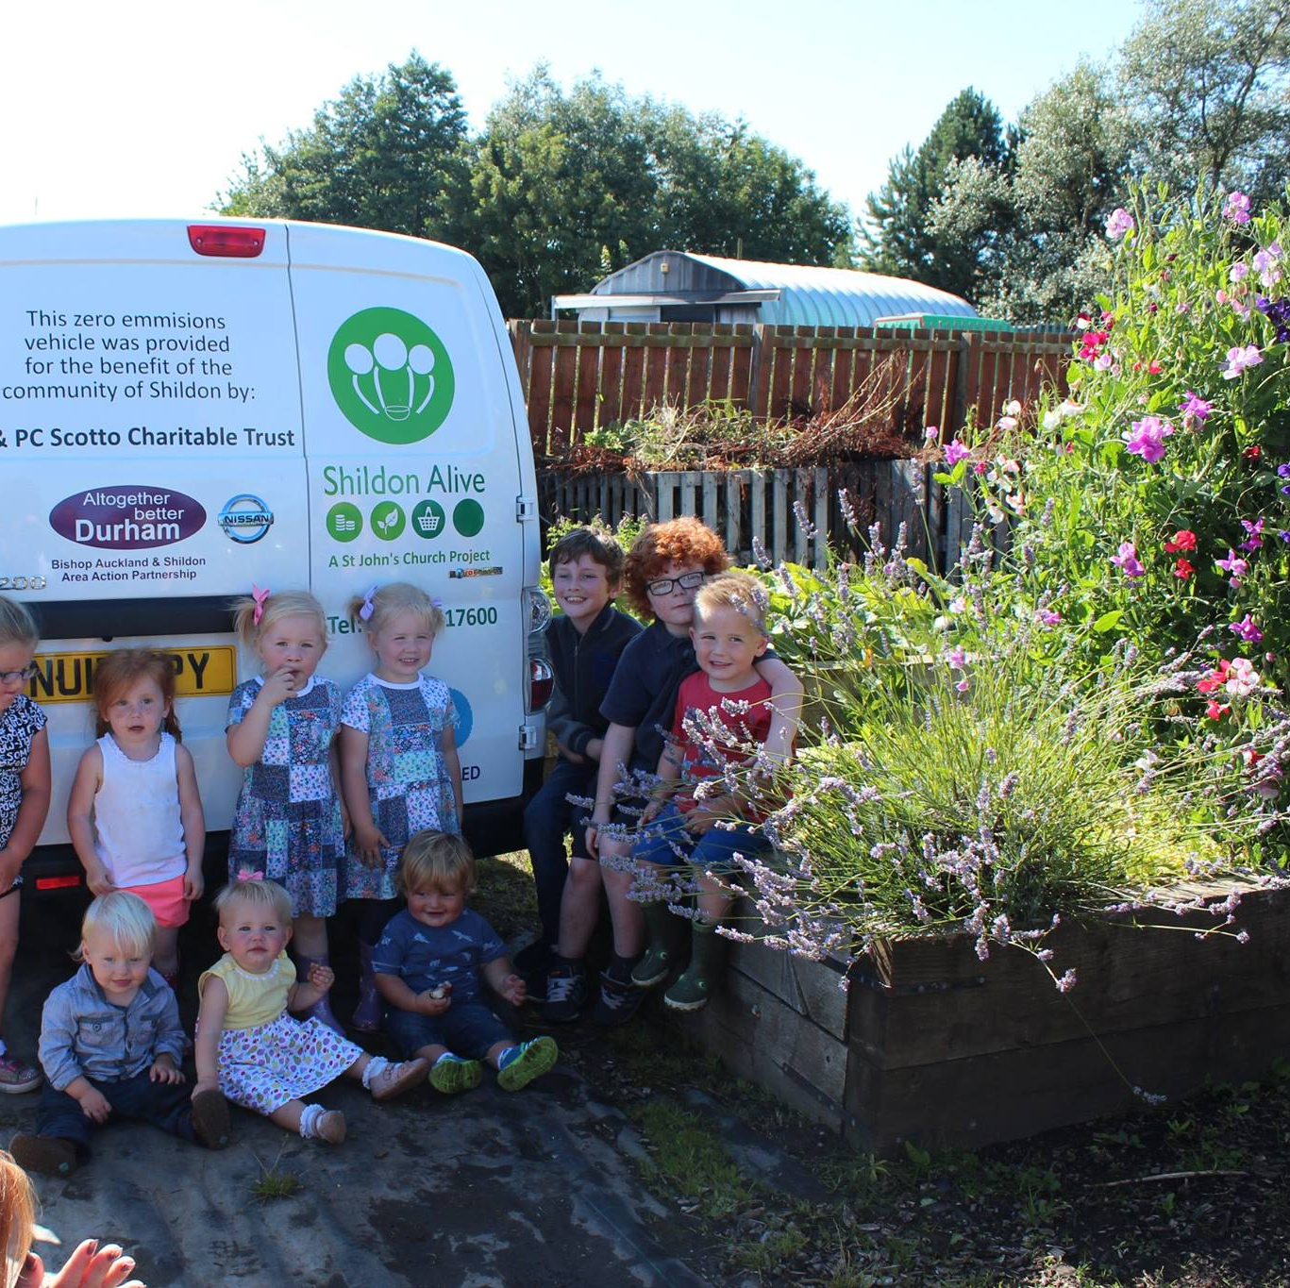
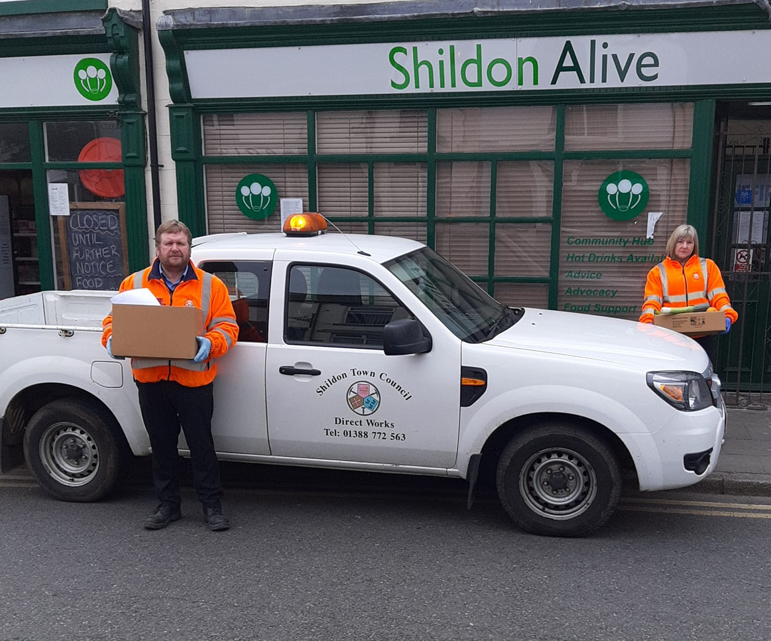
Building connection to place
to local people
to other local organisations
to other services

Slide 7
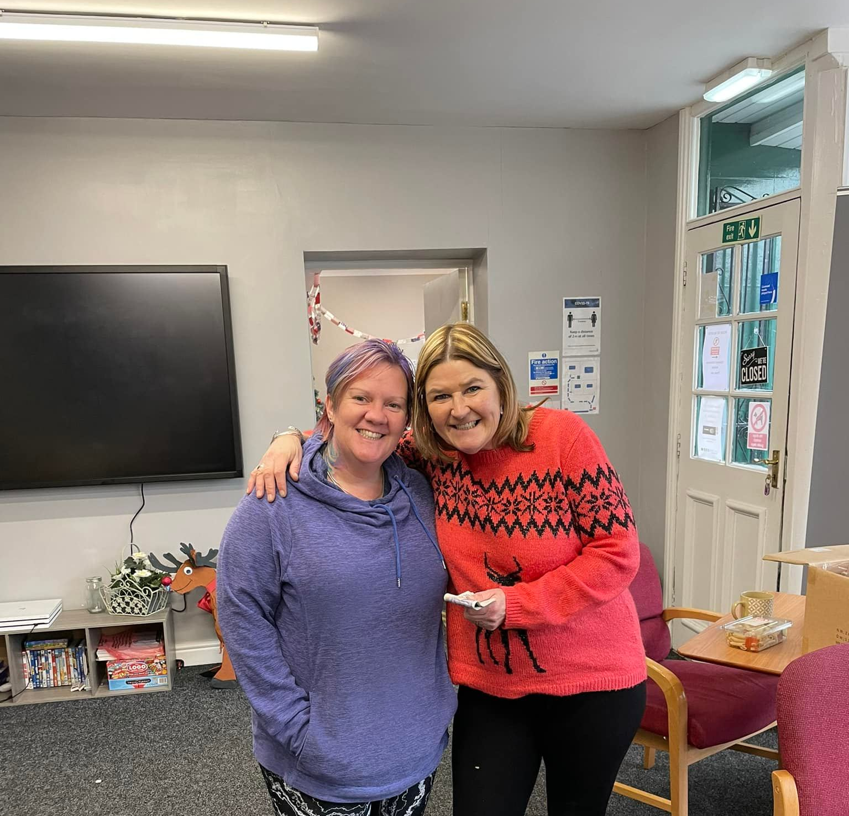
Quick, local, practical response to the Covid Pandemic and more recently Storm Arwen
‘We were so grateful when the staff and volunteers from Shildon alive and Shildon Town Council turned up with hot food, blankets and flasks. Life savers, 9 days we were left without electricity. We’ve had a collection for them to say thanks’ local resident

Slide 8
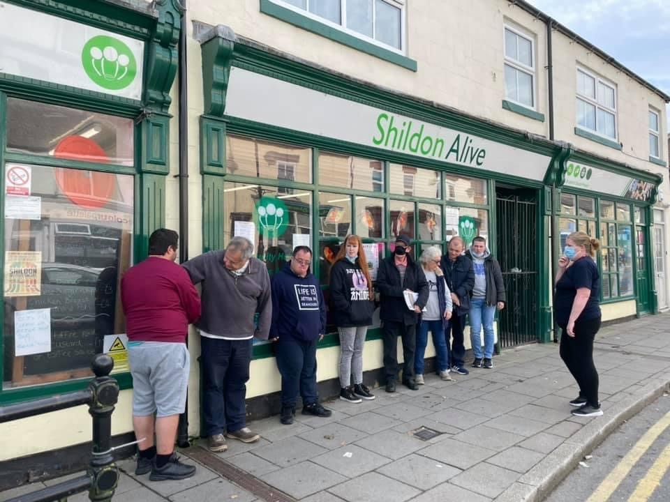
Supporting all Communities
Good at dealing with complex cases, taking the time to support a client to a better place

Slide 9
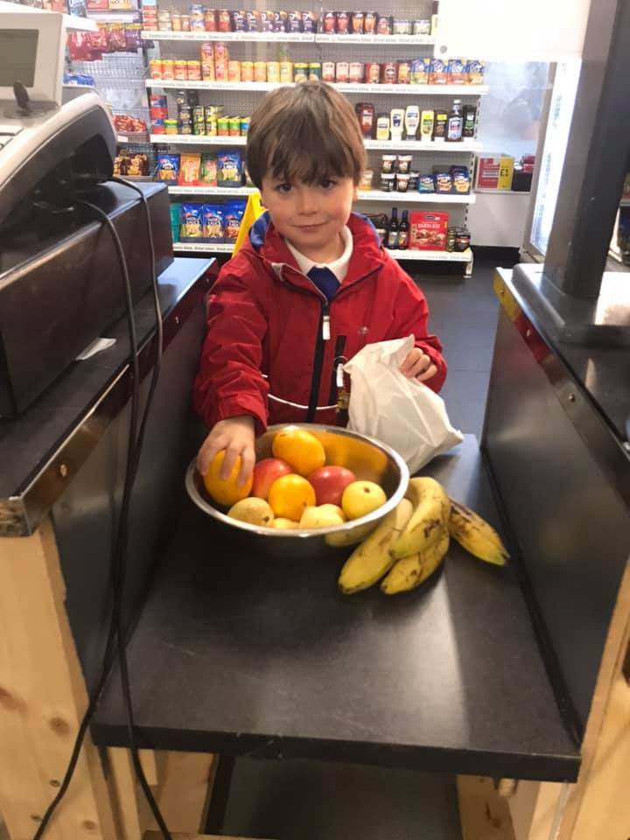
Where we are now
We currently employ 7 staff and 35 volunteers
Run a social enterprise takeaway and shop, rescuing 44 tonnes of food last year and sharing it with our community
Provided 3000 meals to children over the Summer holidays
Supported over 6000 families and individuals living in food poverty
Delivered Advocacy support to 1341
Provided £8000 of grant funding to individuals in crisis

Slide 11
Funders and Partners who help us support our communities

Slide 12
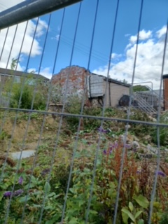
Next steps
After working closely with Durham Community Action to secure our first property with a view to becoming Community led landlords, we have secured our first home and we are supporting the tenant and her 6 children.
The tenant now volunteers for us and regularly takes part in activities with us.
We have secured an Option on a piece of land to build an ECO Shildon Alive headquarters.

