Slide 1
Bi-directional engagement with research in narrative and health
Dr Laura Mazzoli Smith
Durham University, UK
laura.d.mazzolismith@durham.ac.uk

Slide 2
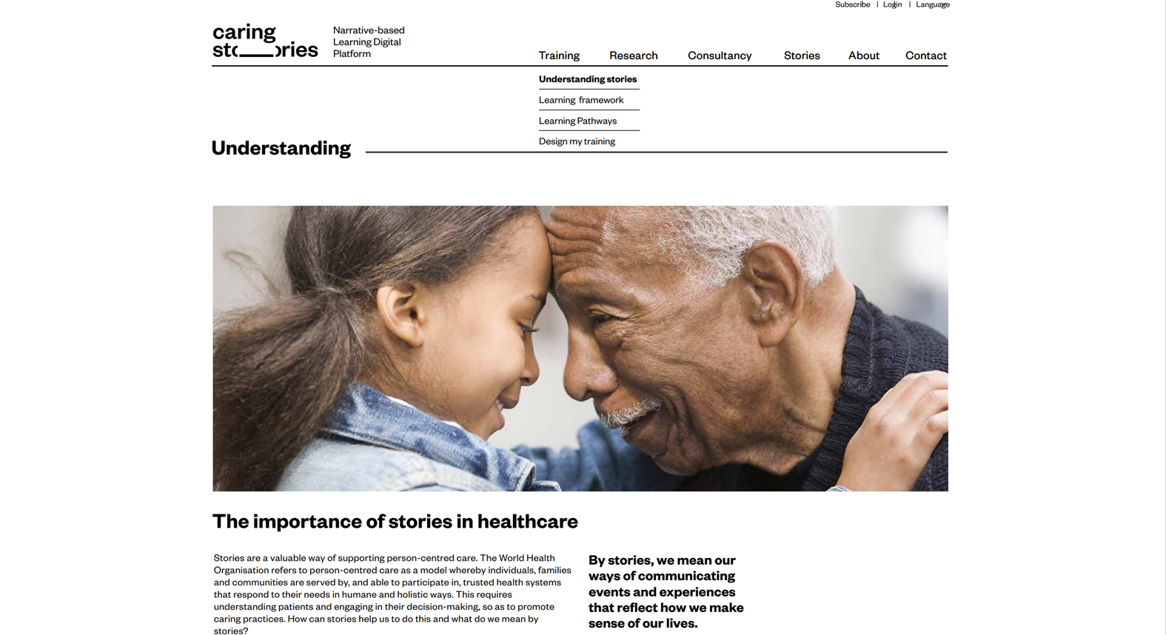
The importance of narratives in healthcare
To foster sense-making and sense-gathering for multiple stakeholders
To support the exchange of tacit knowledge and knowledge translation
To support more direct educational aims
To promote attributes (narrative competencies)
e.g. empathy, compassion, listening
5. Storytelling provides as voice and agency

Slide 3
Narrative knowledge
Narrative cognition (Jerome Bruner)
Narrative rationality – the narrative paradigm (Walter Fisher)
Narrative Medicine (Rita Charon)
‘Narrative knowledge provides one person with a rich, resonant grasp of another person’s situation as it unfolds in time…Unlike scientific knowledge or epidemiological knowledge, which tries to discover things about the natural world that are universally true or at least appear true to any observer, narrative knowledge enables one individual to understand particular events befalling another individual not as an instance of something that is universally true but as a singular and meaningful situation.’ (Charon 2006)

Slide 5
Reflective, dialogic exercises - caring
MODULE 3.
Exercise 3.1First, watch Pat’s story “Learning to navigate” at: https://www.patientvoices.org.uk/flv/0854pv384.htm
What are the metaphors that she uses in her narrative to try to convey the changes in her life?
What genre is her narrative?
Few narratives exist on their own. In health and social care there are always many entwined stories. Now watch the story made by Pat’s husband Tom in the same workshop “I do the best I can” at: https://www.patientvoices.org.uk/flv/0855pv384.htm
How do common metaphors link the two narratives? How does the genre of Tom’s narrative differ from Pat’s?
Watch Monica’s story “A part of the team” at: https://www.patientvoices.org.uk/flv/0022pv384.htm
Focus on these questions and using the ‘EAR’ model that was first introduced in module 1, exercise 1.3:
What did it make you think about? (effect)
How did the story make you feel? (affect)
What might you do or think differently as a result of seeing the story? (reflect)

Slide 6
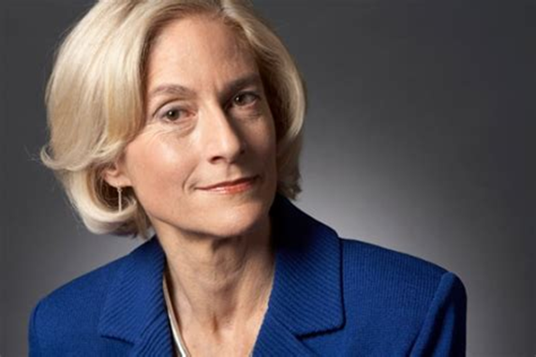
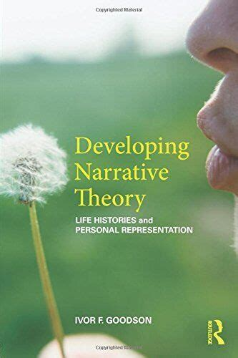
Narrative pedagogy and narrative imagination
Narratives translate abstract or conceptual knowledge as a concrete experience
Exposure to narratives is not enough –
narrative interpretation depends on critical reflection in and through dialogue
Hearing/reading narratives in dialogue draws on the affective, cognitive and experiential domains
‘The ability to be an intelligent reader of another person’s story and to understand the
emotions and wishes and desires that someone so placed might have’ (Cultivating Humanity)
Depends upon a pluralistic conception of human beings
Combines the use of imagination with knowledge in and through a concrete experience
to over-come the limitations of any one particular world-view

Slide 7
